Slide 1

Utility scale dynamic circuits
Mirko Amico Technical Lead – Quantum Algorithm Engineering IBM Quantum
Notes:
Good morning. In this seminar, I am very excited to be able to share new dynamic circuits capabilities that now we are re-introducing as utility scale dynamic circuits.

Slide 2

What is dynamic circuit?
Unitary quantum circuit
Dynamic quantum circuit
feedforward
Classical computation
classically-
controlled gate
Notes:
First, what is a dynamic circuit? When I say the words “quantum circuit”, it’s likely that many of you have pictured in your mind something like what’s on the left-hand side, where I apply a sequence of single and two-qubit unitary gates and make terminal measurements at the end. However, on IBM hardware we have access to a broader set of resources than just unitary gates – we have components like midcircuit measurements, classical computation, and even feedforward, where we take the results of those midcircuit measurements and feed them into the logic of now classically-controlled gates to apply next.

Slide 3

What is dynamic circuit?
Unitary quantum circuit
Dynamic quantum circuit
feedforward
Classical computation
classically-
controlled gate
Dynamic circuits $→$ can implement any allowed quantum process, not just unitary evolution.
Notes:
Taking this broader set of resources altogether allows us to build dynamic quantum circuits,
which are extremely powerful, as unlike static quantum circuits, we can implement any allowed quantum process, not just unitary evolution.

Slide 4
What is dynamic circuit?
Unitary quantum circuit
Dynamic quantum circuit
feedforward
Classical computation
classically-
controlled gate
Dynamic circuits $→$ can implement any allowed quantum process, not just unitary evolution.
Measurements and feedforward $→$ new quantum algorithms?
Notes:
And while we know that building dynamic circuits is an essential ingredient for quantum error correction, it is also interesting to ask – can they be used to discover and realize new quantum algorithms and applications along the way?

Slide 5
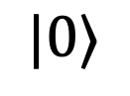
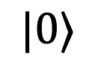
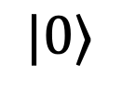
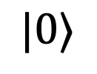
What makes dynamic circuits powerful?
$$|0⟩$$
$$|0⟩$$
$$|0⟩$$
$$|0⟩$$
A spacetime view:
$$|0⟩$$
Spatial resources
$$|0⟩$$
$$|0⟩$$
$$|0⟩$$
$$|0⟩$$
$$|0⟩$$
Temporal resources
Notes:
So dynamic circuits are clearly more general than unitary circuits, but what makes them a promising tool in the near-term?
To illustrate this, let’s consider the spacetime resources needed for a quantum circuit – namely, spatial resources or the number of qubits required, and temporal resources or depth of the circuit. Dynamic circuits have been shown to be useful in reducing both of these types of resources.

Slide 6
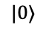
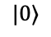
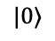
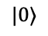
What makes dynamic circuits powerful?
$$|0⟩$$
$$|0⟩$$
$$|0⟩$$
$$|0⟩$$
$$|0⟩$$
$$|0⟩$$
The ability to reset & reuse qubits can reduce spatial overhead
$$|0⟩$$
$$|0⟩$$
$$|0⟩$$
$$|0⟩$$
Notes:
In particular, the ability to reset and reuse qubits can drastically reduce spatial overhead in certain situations.

Slide 7
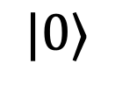




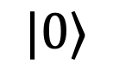

What makes dynamic circuits powerful?
$$|0⟩$$
$$|0⟩$$
$$|0⟩$$
$$|0⟩$$
$$|0⟩$$
$$|0⟩$$
The ability to reset & reuse qubits can reduce spatial overhead
$$|0⟩$$
$$|0⟩$$
$$|0⟩$$
$$|0⟩$$
Example: staircase circuit
$N$ qubits
$$|0⟩$$
$$U$$
$$|0⟩$$
$$U$$
$$|0⟩$$
$$U$$
$$|0⟩$$
$$|0⟩$$
$$U$$
$$|0⟩$$
Notes:
A simple example of this is in the following staircase circuits, where we apply a sequence of two-qubit unitaries and make terminal measurements. Naively running this circuit requires N qubits. However, we can notice that on the left-hand side, each qubit isn’t used at all after the staircase until the measurement. Then we might as well move the measurement up as early as possible, and once we do that, we might as well just reset the measured qubit and use it for the next step of the staircase!

Slide 8
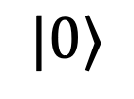
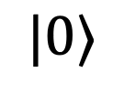

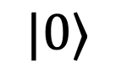


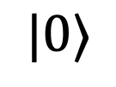
What makes dynamic circuits powerful?
$$|0⟩$$
$$|0⟩$$
$$|0⟩$$
$$|0⟩$$
$$|0⟩$$
$$|0⟩$$
The ability to reset & reuse qubits can reduce spatial overhead
$$|0⟩$$
$$|0⟩$$
$$|0⟩$$
$$|0⟩$$
Example: staircase circuit
$N$ qubits
2 qubits!
$$|0⟩$$
$$U$$
$$|0⟩$$
$$|0⟩$$
$$U$$
$$\tilde{U}$$
$$\tilde{U}$$
$$\tilde{U}$$
$$|0⟩$$
$$|0⟩$$
$$|0⟩$$
$$|0⟩$$
$$U$$
$$|0⟩$$
$$|0⟩$$
See related work on so-called holographic algorithms
$$U$$
Foss-Feig et al., Phys. Rev. Research (2022)
$$|0⟩$$
Chertkov et al., Nat. Phys (2022)
Decross et al., PRX (2023)
Notes:
Putting this together, we see that the results of the left-hand circuit are entirely equivalent to the results of the right which needs only two qubits, independent of how big the staircase is. This is just one example of how dynamic circuits can be leveraged to drastically reduce the number of qubits needed to implement quantum circuits with certain structure. However, they are not only helpful for reducing spatial resources…

Slide 9
What makes dynamic circuits powerful?
$$|0⟩$$
$$|0⟩$$
$$|0⟩$$
$$|0⟩$$
$$|0⟩$$
$$|0⟩$$
Measurements and feedforward can reduce temporal overhead
$$|0⟩$$
$$|0⟩$$
$$|0⟩$$
$$|0⟩$$
Notes:
But we can additionally reduce temporal resources, or depth, needed for certain problems.

Slide 10
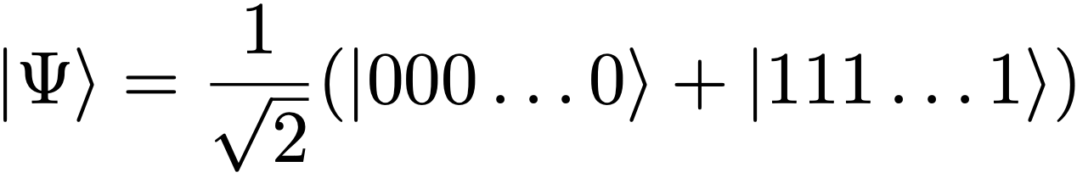
What makes dynamic circuits powerful?
$$|0⟩$$
$$|0⟩$$
$$|0⟩$$
$$|0⟩$$
$$|0⟩$$
$$|0⟩$$
Measurements and feedforward can reduce temporal overhead
$$|0⟩$$
$$|0⟩$$
$$|0⟩$$
$$|0⟩$$
Example: GHZ state preparation
Notes:
A great example of this is in preparing the GHZ state, which is the equal superposition of all zeros and all ones. To make things simple, let’s imaging we want to prepare this state on a 1D line.

Slide 11



What makes dynamic circuits powerful?
$$|0⟩$$
$$|0⟩$$
$$|0⟩$$
$$|0⟩$$
$$|0⟩$$
$$|0⟩$$
Measurements and feedforward can reduce temporal overhead
$$|0⟩$$
$$|0⟩$$
$$|0⟩$$
$$|0⟩$$
Unitary: $O(N)$ depth
Example: GHZ state preparation
Notes:
Then if we only have static, unitary circuits, the best we can do is the circuit on the left-hand side, which prepares the state by starting from the center, and grows the correlations in both directions with a ladder of CNOT gates. This circuit requires a depth that is linear in the size of the state. So a bigger GHZ state means we need a deeper and deeper circuit.

Slide 12
What makes dynamic circuits powerful?
$$|0⟩$$
$$|0⟩$$
$$|0⟩$$
$$|0⟩$$
$$|0⟩$$
$$|0⟩$$
Measurements and feedforward can reduce temporal overhead
$$|0⟩$$
$$|0⟩$$
$$|0⟩$$
$$|0⟩$$
Unitary: $O(N)$ depth
Example: GHZ state preparation
There is a speed-limit for unitarily spreading correlations
Bravyi et al., PRL (2006)
Notes:
The reason for this is fundamental: there is a speed-limit for how fast we can unitarily spread correlations, and in this circuit we are spreading those correlations at a maximal speed along the edge of a lightcone. However, with dynamic circuits we can completely break this speed limit.

Slide 13

What makes dynamic circuits powerful?
$$|0⟩$$
$$|0⟩$$
$$|0⟩$$
$$|0⟩$$
$$|0⟩$$
$$|0⟩$$
Measurements and feedforward can reduce temporal overhead
$$|0⟩$$
$$|0⟩$$
$$|0⟩$$
$$|0⟩$$
Unitary: $O(N)$ depth
Example: GHZ state preparation
Dynamic: $O\left(1\right)$ depth
There is a speed-limit for unitarily spreading correlations
Classical Computation
Bravyi et al., PRL (2006)
Notes:
In particular, by strategically leveraging midcircuit measurements, classical computation, and feedforward, you can prepare a GHZ state in constant depth, meaning the depth is completely independent of the size of the GHZ state. A 1000 qubit GHZ state requires the same depth circuit as a 10 qubit one. The way we do this is with this circuit on the right which is a bit more difficult to parse…

Slide 14
What makes dynamic circuits powerful?
$$|0⟩$$
$$|0⟩$$
$$|0⟩$$
$$|0⟩$$
$$|0⟩$$
$$|0⟩$$
Measurements and feedforward can reduce temporal overhead
$$|0⟩$$
$$|0⟩$$
$$|0⟩$$
$$|0⟩$$
Unitary: $O(N)$ depth
Example: GHZ state preparation
Dynamic: $O\left(1\right)$ depth
There is a speed-limit for unitarily spreading correlations
Classical Computation
Bravyi et al., PRL (2006)
Notes:
But the high-level idea is that we are preparing lots of little GHZ states and then fusing them together with measurements. Then, because the measurement outcomes are inherently probabilistic, we apply X gates to make local corrections on the state conditioned on those outcomes. Altogether, this ability to reduce circuit depth is one of the most powerful features of dynamic circuits, and it’s why we are so excited to bring our new dynamic circuits capabilities to you.

Slide 15
Applications of dynamic circuits (beyond error correction)
State preparation
Long-range entangled states [1]
Matrix product states [2]
Topologically ordered states [3]
Gibbs states [4]
Non-unitary processes
Driven-dissipative dynamic
Measurement-induced phase transitions [5]
Nonlinear transformations [6]
System
Environment
Unitary compilation
Long-range entangling gates [1]
Many-qubit gates (e.g. fanout) [7]
Distributed quantum computing
[1] Bäumer et al., PRX Quantum (2024); [2] Smith et al., PRX Quantum (2024); [3] Tanitasadakarn et al., PRX Quantum (2023);
[4] Lin et al., arXiv: 2505.21308 (2025); [5] Skinner et al., PRX (2019); [6] Holmes et al., PRResearch (2023); [7] Bäumer et al, PRResearch (2024)
Notes:
There are already many neat ideas for how these capabilities can be used to explore different applications. These range from the preparation of a wide variety of states, to realizing certain non-unitary processes. You can even more efficiently compile certain unitary primitives by using non-unitary ingredients.

Slide 16
Applications of dynamic circuits (beyond error correction)
State preparation
Long-range entangled states [1]
Matrix product states [2]
Topologically ordered states [3]
Gibbs states [4]
Non-unitary processes
Driven-dissipative dynamic
Measurement-induced phase transitions [5]
Nonlinear transformations [6]
System
Environment
Unitary compilation
Long-range entangling gates [1]
Many-qubit gates (e.g. fanout) [7]
Distributed quantum computing
[1] Bäumer et al., PRX Quantum (2024); [2] Smith et al., PRX Quantum (2024); [3] Tanitasadakarn et al., PRX Quantum (2023);
[4] Lin et al., arXiv: 2505.21308 (2025); [5] Skinner et al., PRX (2019); [6] Holmes et al., PRResearch (2023); [7] Bäumer et al, PRResearch (2024)
Notes:
In this talk, I will focus on state preparation and, in particular, show how the new dynamic circuits capabilities can be leveraged to improve the preparation of a many-qubit entangled state known as the AKLT state.

Slide 17
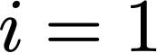
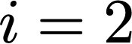
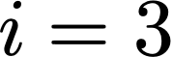
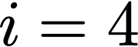
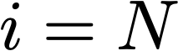
Affleck-Kennedy-Lieb-Tasaki (AKLT) state
Spin-1 chain: encode each spin-1 site with a pair of qubits
[1] Pollman et al, PRB (2012); [2] Verstraete et al, PRA (2004); [3] Brennen et al, PRL (2008); [4] Smith et al PRXQ (2023); [5] Smith et al PRXQ (2024)
Notes:
First, what is the AKLT state and why prepare it? It is a historically important state that describes a spin chain composed of spin-1 particles, which we can encode using a pair of qubits per site.

Slide 18
Affleck-Kennedy-Lieb-Tasaki (AKLT) state
Spin-1 chain: encode each spin-1 site with a pair of qubits
A prototypical example of a matrix product state (MPS)
[1] Pollman et al, PRB (2012); [2] Verstraete et al, PRA (2004); [3] Brennen et al, PRL (2008); [4] Smith et al PRXQ (2023); [5] Smith et al PRXQ (2024)
Notes:
(1) This is a prototypical example of both a matrix product state

Slide 19
Affleck-Kennedy-Lieb-Tasaki (AKLT) state
Spin-1 chain: encode each spin-1 site with a pair of qubits
A prototypical example of a matrix product state (MPS)
An example of symmetry-protected topological (SPT) order [1]
[1] Pollman et al, PRB (2012); [2] Verstraete et al, PRA (2004); [3] Brennen et al, PRL (2008); [4] Smith et al PRXQ (2023); [5] Smith et al PRXQ (2024)
Notes:
(2) as well as symmetry-protected topological order which lends it a number of interesting exotic features.

Slide 20
Affleck-Kennedy-Lieb-Tasaki (AKLT) state
Spin-1 chain: encode each spin-1 site with a pair of qubits
A prototypical example of a matrix product state (MPS)
An example of symmetry-protected topological (SPT) order [1]
A resource for measurement-based quantum computation [2-3]
[1] Pollman et al, PRB (2012); [2] Verstraete et al, PRA (2004); [3] Brennen et al, PRL (2008); [4] Smith et al PRXQ (2023); [5] Smith et al PRXQ (2024)
Notes:
(3) It is also a useful resource state for tasks such as measurement based quantum computation and,

Slide 21
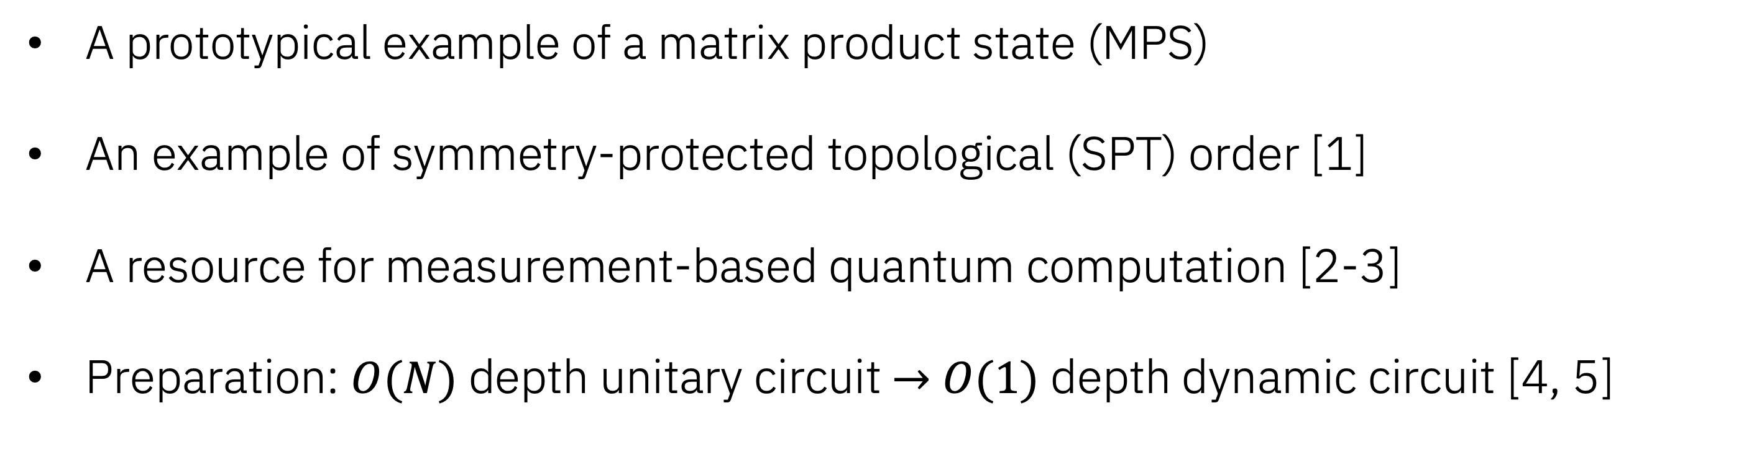
Affleck-Kennedy-Lieb-Tasaki (AKLT) state
Spin-1 chain: encode each spin-1 site with a pair of qubits
A prototypical example of a matrix product state (MPS)
An example of symmetry-protected topological (SPT) order [1]
A resource for measurement-based quantum computation [2-3]
Preparation: $O(N)$ depth unitary circuit $→$ $O(1)$ depth dynamic circuit [4, 5]
[1] Pollman et al, PRB (2012); [2] Verstraete et al, PRA (2004); [3] Brennen et al, PRL (2008); [4] Smith et al PRXQ (2023); [5] Smith et al PRXQ (2024)
Notes:
(4) most importantly in the context of today’s talk, with unitary circuits, the prototypical way to prepare it is with a linear depth unitary circuit. However, with dynamic circuits, this can be reduced to a constant-depth circuits, an impossibility with static circuits alone.

Slide 22
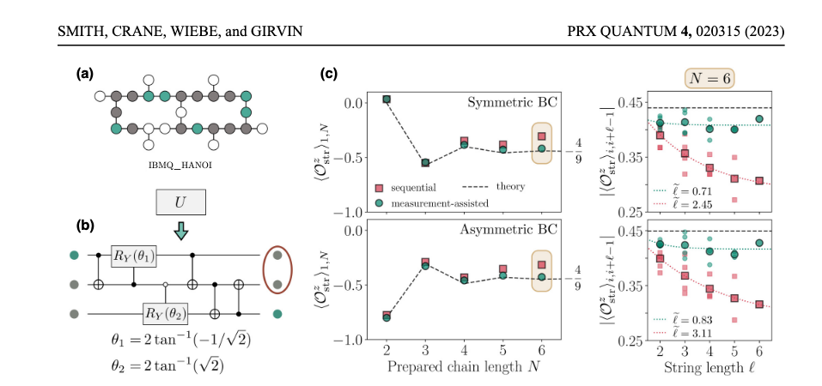
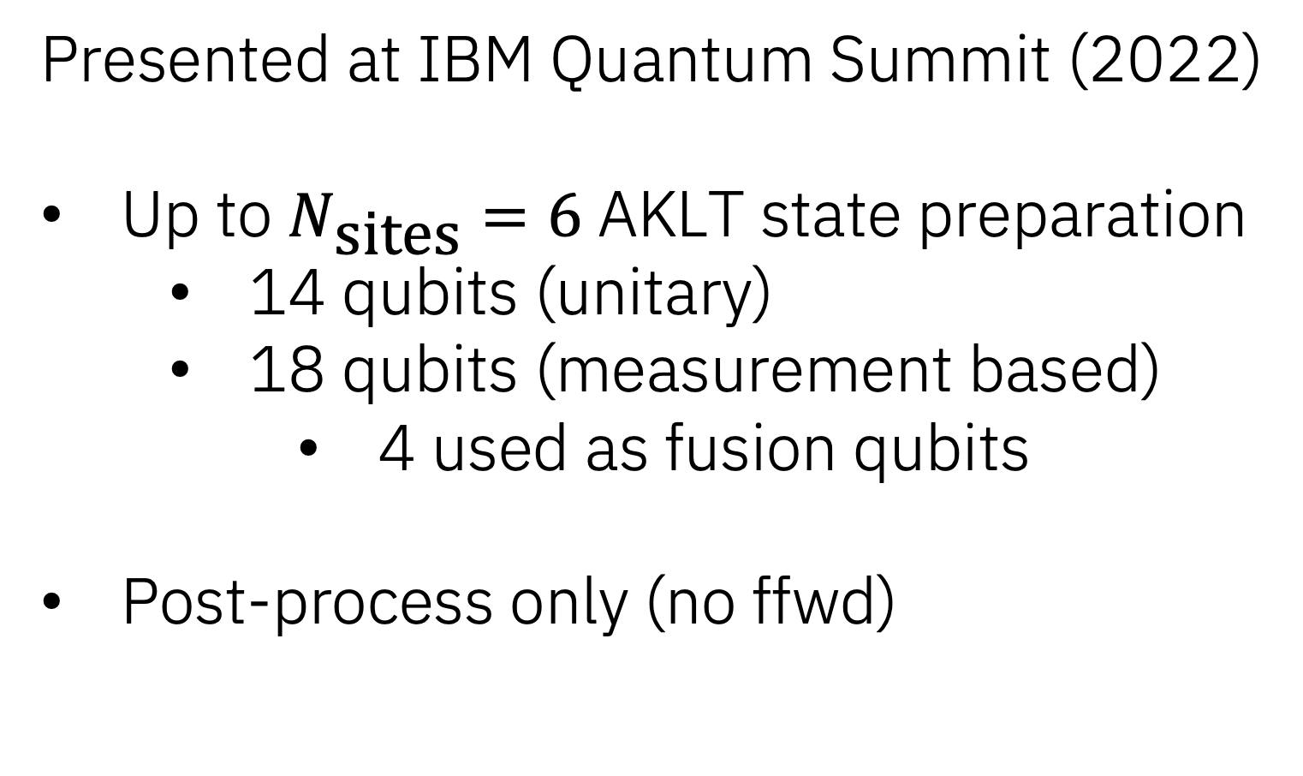
Dynamic circuits (initial release)
Presented at IBM Quantum Summit (2022)
Up to $N_{\text{sites}}=6$ AKLT state preparation
14 qubits (unitary)
18 qubits (measurement based)
4 used as fusion qubits
Post-process only (no ffwd)
Notes:
The preparation of this state on IBM hardware was first presented at the IBM Quantum Summit in 2022. At that time, experiments were limited to up to 6 spin-1 sites, requiring 14 qubits total for unitary-based preparation and 18 qubits for the measurement-based scheme, with the additional four qubits being needed for “fusion” measurements. At the time this paper was published, only post-processing was possible – meaning no active feedforward was used, and all corrections on the state were done virtually in postprocessing.

Slide 23
Dynamic circuits (initial release)
Presented at IBM Quantum Summit (2022)
Up to $N_{\text{sites}}=6$ AKLT state preparation
14 qubits (unitary)
18 qubits (measurement based)
4 used as fusion qubits
Post-process only (no ffwd)
Dynamic circuits capability introduced at the summit in 2022 enabled this experiment to run with real time feed-forward!
But with some challenges and limitations…
Notes:
The dynamic circuits capabilities introduced in 2022 enabled this experiment to run with real-time feedforward, (1) but this inherently came with certain limitations…

Slide 24
Re-introduction of Dynamic Circuits
Previous version
Parallel feed forward operations limited to 10 bit input using Switch
Up to 12 site AKLT state
Notes:
In particular, the previous version of dynamic circuits required conditional operations to be done sequentially, adding around 700ns extra latency per IF statement. Introduction to SWITCH statement later on, allowed for almost parallel feedforward operations, but only up to 10 bits. In the context of the AKLT state, this meant we could only prepare up to a 12 site AKLT state within a reasonable latency.

Slide 25
Re-introduction of Dynamic Circuits
Previous version
Parallel feed forward operations limited to 10 bit input using Switch
Up to 12 site AKLT state
Measurement used mid-circuit and terminal were all the same
Notes:
Furthermore, there was no differentiation between the terminal and mid-circuit measurements…..

Slide 26
Re-introduction of Dynamic Circuits
Previous version
Parallel feed forward operations limited to 10 bit input using Switch
Up to 12 site AKLT state
Measurement used mid-circuit and terminal were all the same
Non-deterministic timing
Dynamical decoupling limited to static part of the circuit
Notes:
and the circuit timings were non-deterministic, so we were not able to make use of the feedforward time, but just wait. This prohibited application of any instructions during the idling time, and made it difficult to implement error suppression techniques, such as dynamical decoupling, in the non-static parts of the circuit.

Slide 27
Re-introduction of Dynamic Circuits
Previous version
Parallel feed forward operations limited to 10 bit input using Switch
Up to 12 site AKLT state
Measurement used mid-circuit and terminal were all the same
Non-deterministic timing
Dynamical decoupling limited to static part of the circuit
No visualization of scheduled circuit made it challenging
Notes:
Lastly, from a user perspective it was opaque – there was no way to obtain the scheduled circuit, nor visualize it.

Slide 28
Re-introduction of Dynamic Circuits
Previous version
Parallel feed forward operations limited to 10 bit input using Switch
Up to 12 site AKLT state
Measurement used mid-circuit and terminal were all the same
Non-deterministic timing
Dynamical decoupling limited to static part of the circuit
No visualization of scheduled circuit made it challenging
New dynamic circuits features
Parallel ifs / feed forward operations
Demonstrate up to 30 site AKLT state using 90 qubits
Notes:
In the new dynamic circuits release, we are happy to have resolved many of these challenges. Rather than relying on a switch statement, users can now implement parallel ”if” blocks which, in our example, enables the preparation of 30 site AKLT states involving 90 qubits, with only single overhead for all the feedforward operations, rather than applying them sequentially. To put some approximate numbers, previous version of dynamic circuits would have required more than 25us longer to prepare a 30 site AKLT state.

Slide 29
Re-introduction of Dynamic Circuits
Previous version
Parallel feed forward operations limited to 10 bit input using Switch
Up to 12 site AKLT state
Measurement used mid-circuit and terminal were all the same
Non-deterministic timing
Dynamical decoupling limited to static part of the circuit
No visualization of scheduled circuit made it challenging
New dynamic circuits features
Parallel ifs / feed forward operations
Demonstrate up to 30 site AKLT state using 90 qubits
Faster, independently calibrated MidCircuitMeasure enabled
Notes:
A new MidCircuitMeasure component has been added, which enables faster, independently calibrated measurements for these types of circuits.

Slide 30
Re-introduction of Dynamic Circuits
Previous version
Parallel feed forward operations limited to 10 bit input using Switch
Up to 12 site AKLT state
Measurement used mid-circuit and terminal were all the same
Non-deterministic timing
Dynamical decoupling limited to static part of the circuit
No visualization of scheduled circuit made it challenging
New dynamic circuits features
Parallel ifs / feed forward operations
Demonstrate up to 30 site AKLT state using 90 qubits
Faster, independently calibrated MidCircuitMeasure enabled
Stretch enables better implementation of dynamical decoupling during feed-forward time
Notes:
The Stretch instruction provides users the ability to have greater control over timings, enabling the implementation of dynamic decoupling during feedforward time.

Slide 31
Re-introduction of Dynamic Circuits
Previous version
Parallel feed forward operations limited to 10 bit input using Switch
Up to 12 site AKLT state
Measurement used mid-circuit and terminal were all the same
Non-deterministic timing
Dynamical decoupling limited to static part of the circuit
No visualization of scheduled circuit made it challenging
New dynamic circuits features
Parallel ifs / feed forward operations
Demonstrate up to 30 site AKLT state using 90 qubits
Faster, independently calibrated MidCircuitMeasure enabled
Stretch enables better implementation of dynamical decoupling during feed-forward time
Scheduled circuits are returned (beta) to help with debugging and optimization
Notes:
And finally, scheduled circuits can now be visualized – a helpful tool for debugging and optimizing circuits.

Slide 32
AKLT state preparation with utility scale dynamic circuits
Different methods to prepare the AKLT states:
Unitary
Measurement based without dynamic circuits (post-process)
Measurement based with dynamic circuits (real-time feed-forward)
Hybrid (combine unitary and dynamic)
Notes:
To demonstrate how all of these new capabilities lend themselves to new possibilities with dynamic circuits, let’s dive into this specific example of preparing the AKLT state. There are a number of different methods for preparing this state. Today, we will focus on…
a unitary-based version,
a measurement-based approach where we do not use dynamic circuits, but instead make any corrections in post-processing. We note that this does not prepare the actual state on hardware in a fixed basis, but is instead like preparing it in a local basis that is determined on the fly by the measurement results. Nonetheless, it can give us a sense for how well the different components of the circuit are working.
A measurement-based approach that uses actual dynamic circuits with real-time feedforward,
And a hybrid approach that blends unitary and dynamic circuit techniques.

Slide 33
AKLT state preparation with utility scale dynamic circuits
Different methods to prepare the AKLT states:
Unitary
Measurement based without dynamic circuits (post-process)
Measurement based with dynamic circuits (real-time feed-forward)
Hybrid (combine unitary and dynamic)
What changes in the circuit:
Extra ancilla qubits needed
Depths of the circuit: 2Q gate and measurement layers
Notes:
From method-to-method, there is a spacetime tradeoff in that the measurement-based approaches drastically reduce the depth of the circuit, but requires a greater number of qubits to carry out the fusion measurements.

Slide 34
AKLT state preparation with utility scale dynamic circuits
Different methods to prepare the AKLT states:
Unitary
Measurement based without dynamic circuits (post-process)
Measurement based with dynamic circuits (real-time feed-forward)
Hybrid (combine unitary and dynamic)
What changes in the circuit:
Extra ancilla qubits needed
Depths of the circuit: 2Q gate and measurement layers
What features could be used to improve:
Parallel ifs for larger state preparation
Different measurement types
Stretch DD
Visualization (beta) for optimization and debugging
Notes:
On top of these, we can use different features to inspect and improve the preparation, including parallel ifs, different measurement types, stretch DD, and the visualization of timings. In the following slides, I will walk through these different options and show how they impact the preparation of the AKLT state

Slide 35
Validation of AKLT state preparation
String order
Non-zero value: fingerprint of symmetry-protected topological (SPT) order
IBM Quantum
Notes:
To verify the preparation of the AKLT state, we will look at an observable called the string-order. Its exact mathematical form isn’t so important, but the key thing to takeaway is that it is a nonlocal observable that extends across a string of length L, which we can tune. And it is expected to take on a non-zero value for the AKLT state, which you can think of as the fingerprint of its topological order, and that can be calculated analytically as it only depends on the number of lattice sites and not the specific sites chosen for its measurement.

Slide 36
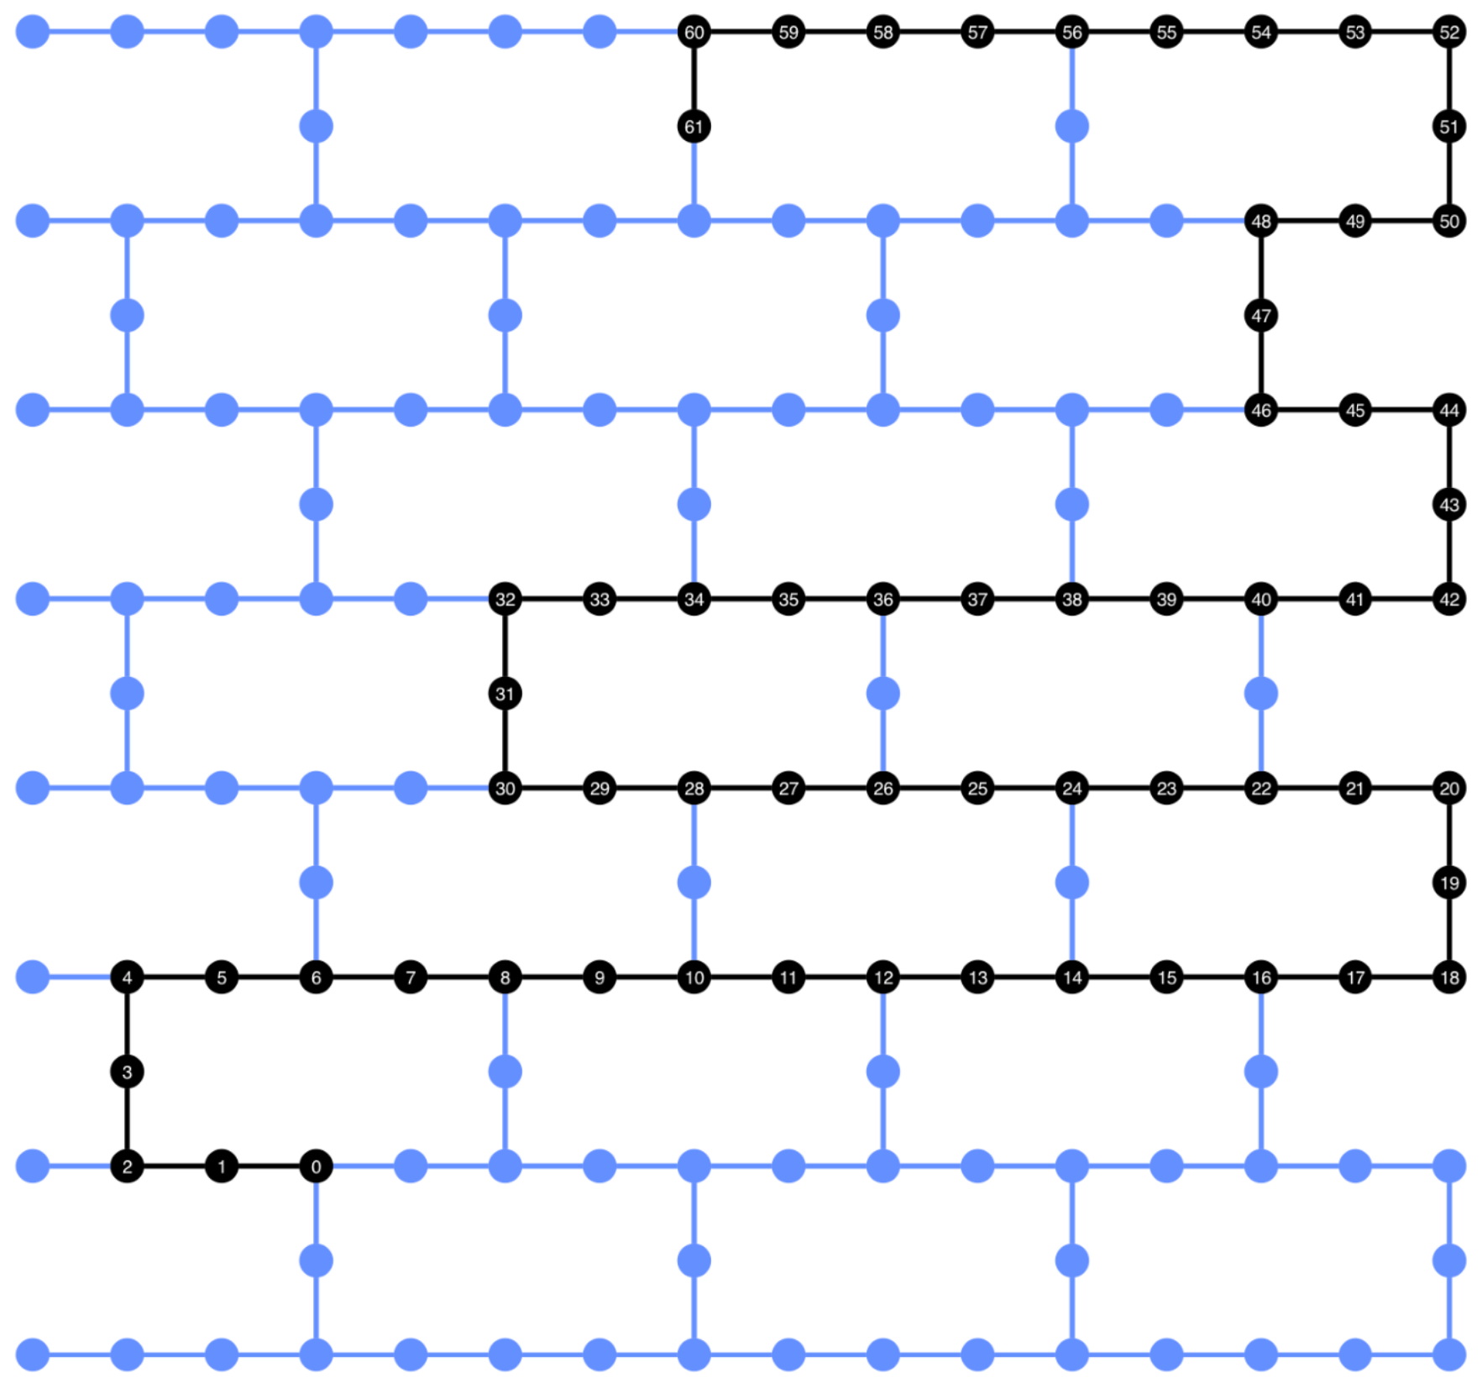
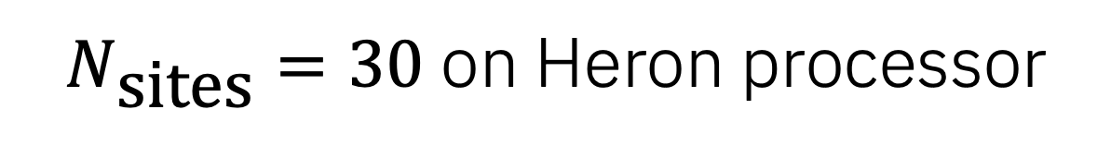
Validation of AKLT state preparation
String order
Non-zero value: fingerprint of symmetry-protected topological (SPT) order
$N_{\text{sites}}=30$ on Heron processor
IBM Quantum
Notes:
In the unitary case, to generate a 30 site AKLT state, we need 60 qubits, with extra ancilla qubits.

Slide 37
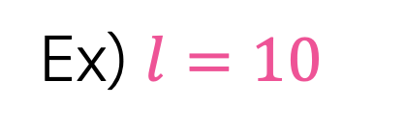

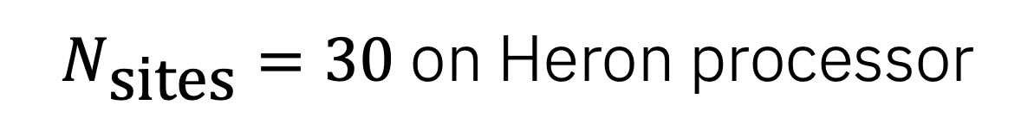
Validation of AKLT state preparation
Ex) $l=10$
String order
Non-zero value: fingerprint of symmetry-protected topological (SPT) order
$N_{\text{sites}}=30$ on Heron processor
21 total $length 10$ chains
IBM Quantum
Notes:
Let’s pick length=10 string order as an example. (---) On an Nsites of 30, there are 21 unique length-10 chains that you can sample from. Throughout this talk, I will use N-site=6 example for visualizing the circuit, while using N-sites=30 data to describe different methods you can use to prepare the AKLT states and how the new dynamic circuits feature come into play when optimizing circuit generations.

Slide 38
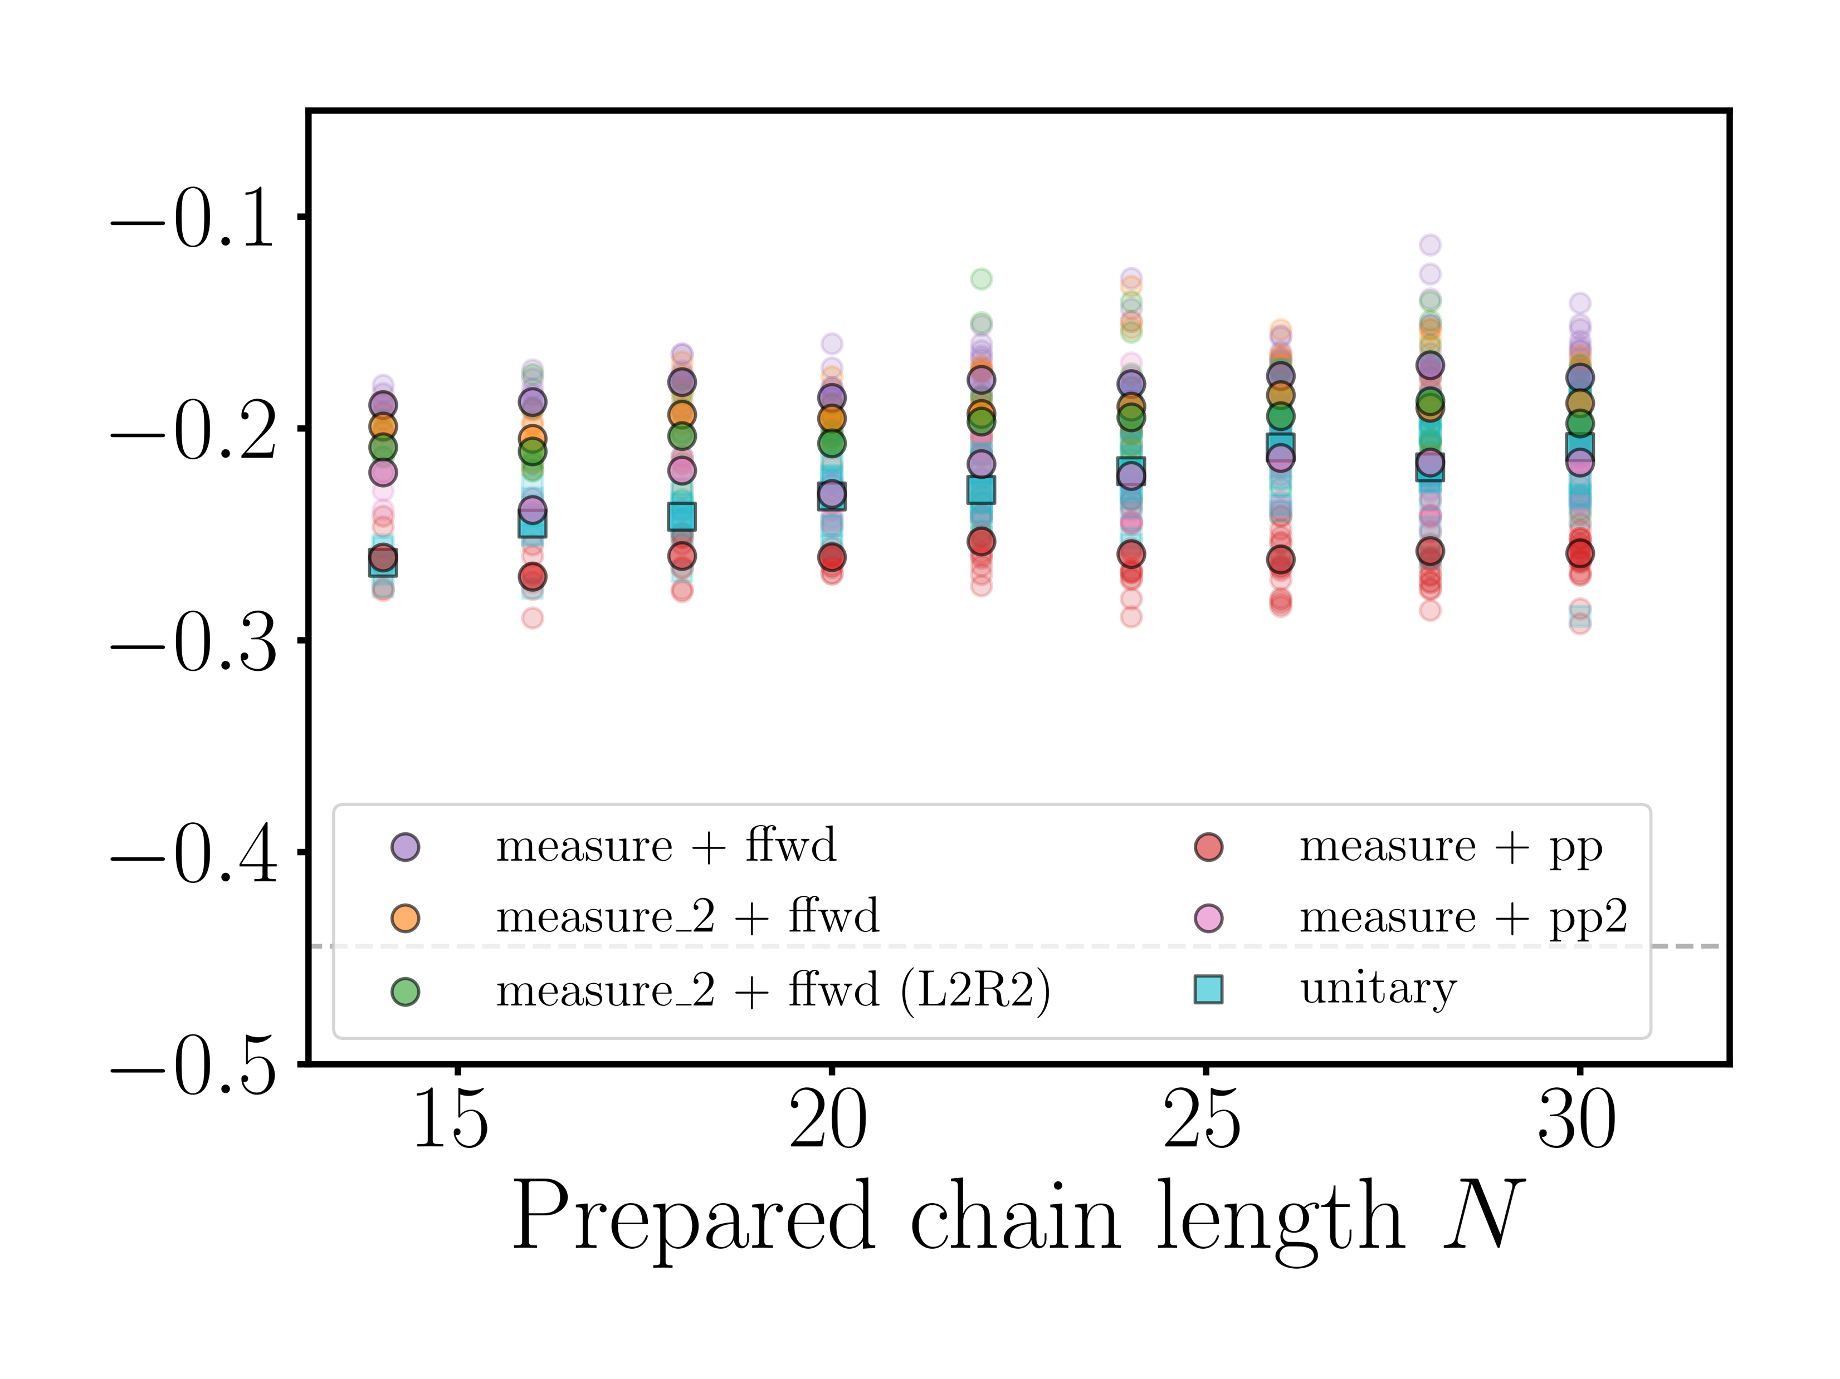

Validation of AKLT state preparation
String order
Non-zero value: fingerprint of symmetry-protected topological (SPT) order
ibm_pittsburgh
$${\left\langle O_{str}^{z}\right\rangle }_{l=10 }$$
IBM Quantum
Notes:
Here, I am plotting the distribution of string order of length-10 across various N-sites, using different methods. Note that the ideal value is at -0.45. When measuring the string order, on top of many 2Q gates you need to prepare the state, you are increasing the size of observables. In these demonstrations, I am not applying any type of error mitigation, and I am happy to still see a good, non-zero signal for weight-20 observables for length-10, at all N-sites.

Slide 39
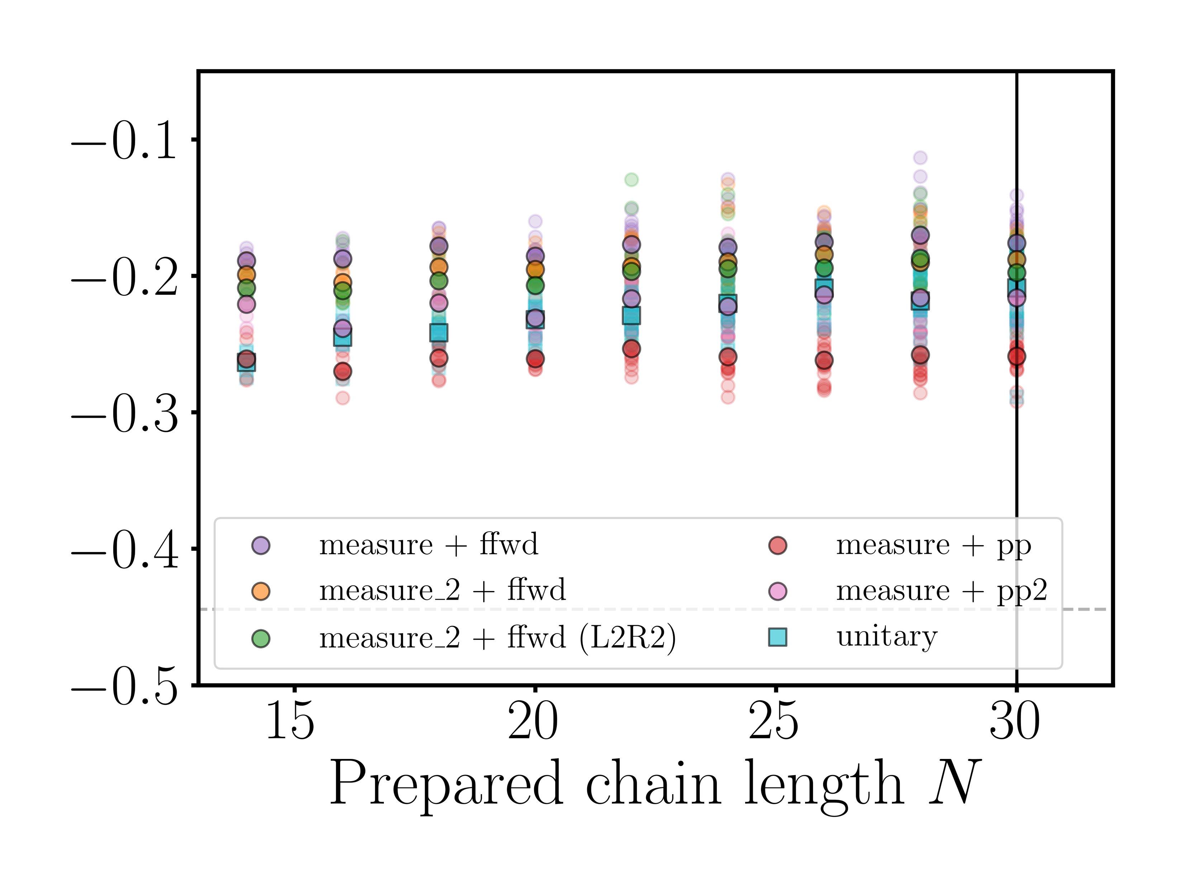
Validation of AKLT state preparation
String order
Non-zero value: fingerprint of symmetry-protected topological (SPT) order
ibm_pittsburgh
$${\left\langle O_{str}^{z}\right\rangle }_{l=10 }$$
Notes:
Throughout this talk, I will use N-site=6 example for visualizing the circuit, while using N-sites=30 data to describe different methods you can use to prepare the AKLT states and how the new dynamic circuits feature come into play when optimizing circuit generations.

Slide 40
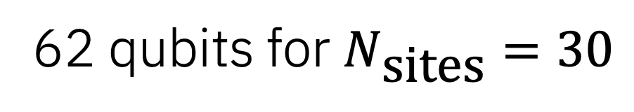
AKLT state preparation with utility scale dynamic circuits
Different methods to prepare the AKLT states:
Unitary
Measurement based without dynamic circuits (post-process)
Measurement based with dynamic circuits (real-time feed-forward)
Hybrid (combine unitary and dynamic)
What changes in the circuit:
Extra ancilla qubits needed
Depths of the circuit: 2Q gate and measurement layers
What features could be used to improve:
Parallel ifs for larger state preparation
Different measurement types
Stretch DD
Visualization (beta) for optimization and debugging
62 qubits for $N_{\text{sites}}=30$
Notes:
So, let’s start with state preparation with unitary only circuit.

Slide 41
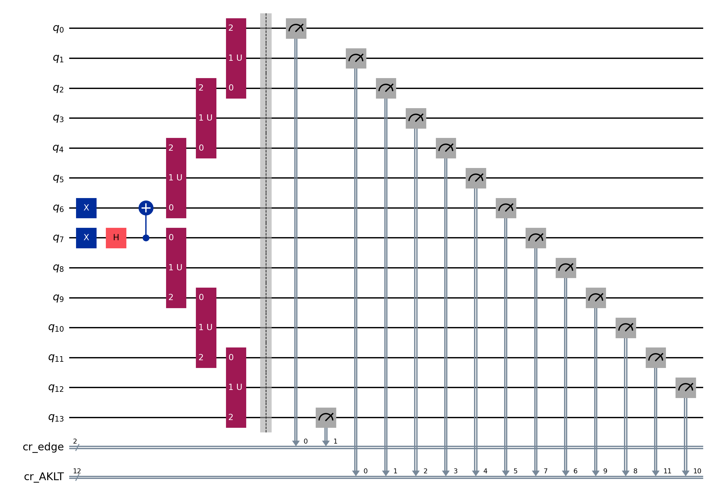
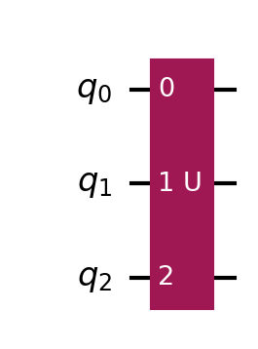
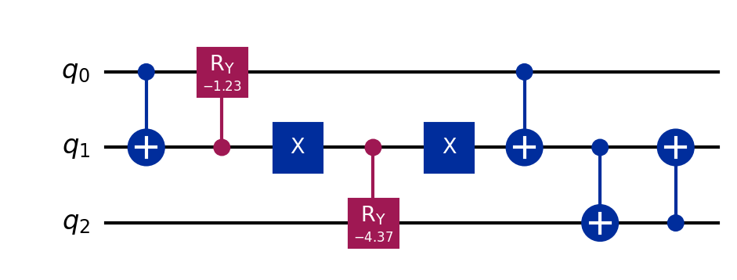
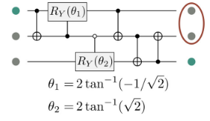
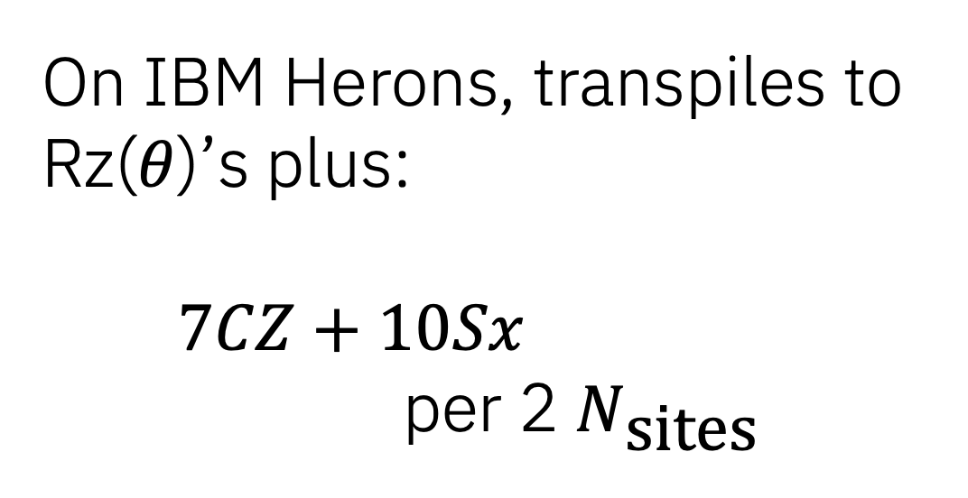
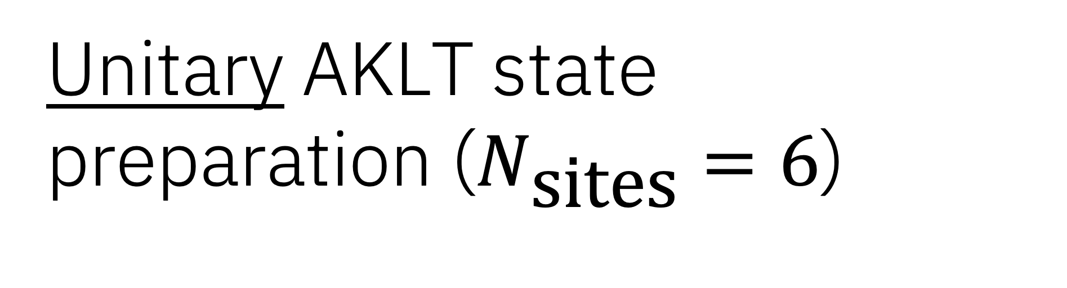
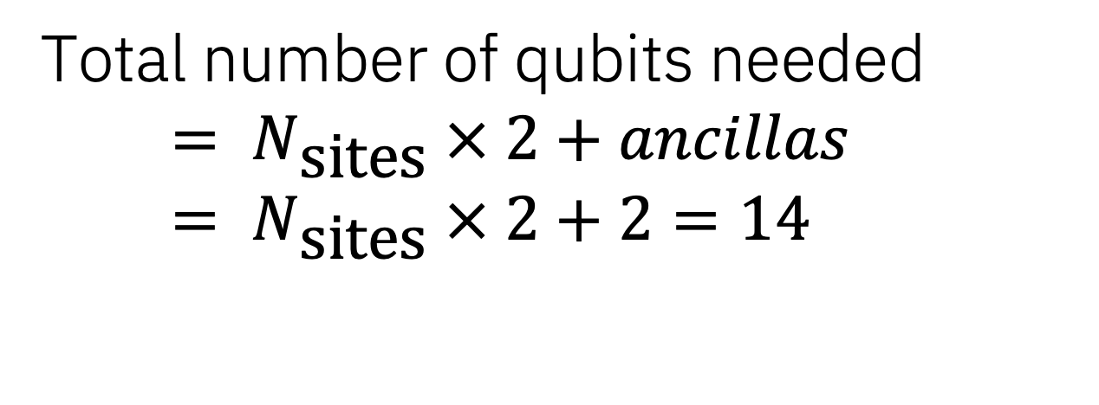
Unitary AKLT state preparation ($N_{\text{sites}}=6$)
Total number of qubits needed
$$= N_{\text{sites}} × 2+ancillas= N_{\text{sites}} × 2+2=14$$
=
On IBM Herons, transpiles to Rz($θ$)’s plus:
$7CZ+10Sx$
per 2 $N_{\text{sites}}$
Notes:
With unitary gates, you can generate AKLT state in this ladder form, just like you might with GHZ state preparation. Each of these red blocks is made of 3-qubits, where you need seven layers of CZ gates along with 10 single qubit gates. By using fractional gates, you can reduce the number of 2Q gates down to 6, but for this talk, I will only show results without using fractional gates.

Slide 42
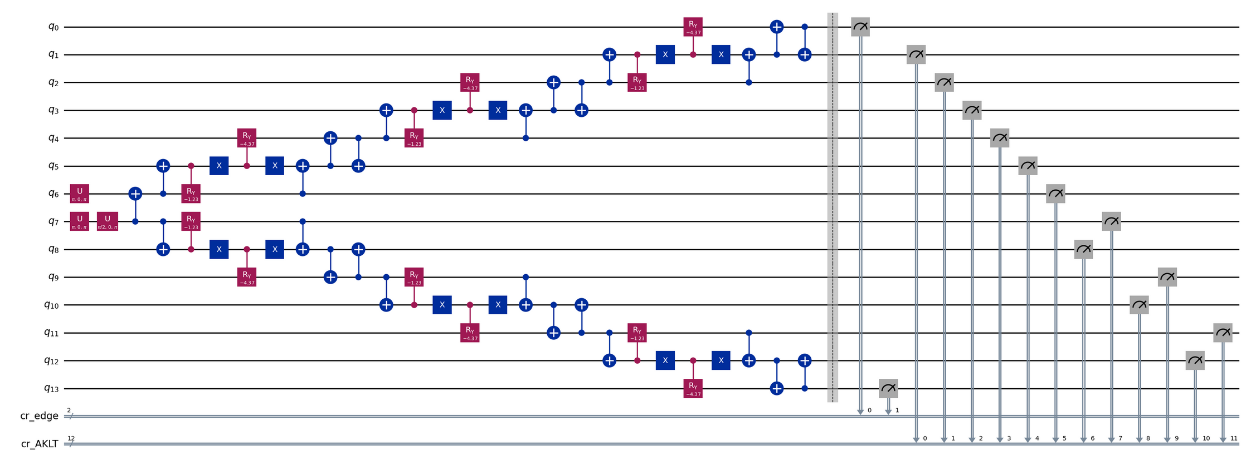
Unitary AKLT state preparation ($N_{\text{sites}}=6$)
Total number of qubits needed
$$= N_{\text{sites}} × 2+ancillas= N_{\text{sites}} × 2+2=14$$
Notes:
In qiskit, you can use the circuit drawer to see how the circuit depth might grow, but this type of drawing doesn’t have any concept of timing. While there are tools such as “timeline_drawer” you can use for static circuit, it doesn’t return the absolute timing that the low-level compiler might generate.

Slide 43
AKLT state preparation with utility scale dynamic circuits
Different methods to prepare the AKLT states:
Unitary
Measurement based without dynamic circuits (post-process)
Measurement based with dynamic circuits (real-time feed-forward)
Hybrid (combine unitary and dynamic)
What changes in the circuit:
Extra ancilla qubits needed
Depths of the circuit: 2Q gate and measurement layers
What features could be used to improve:
Parallel ifs for larger state preparation
Different measurement types
Stretch DD
Visualization (beta) for optimization and debugging
62 qubits for $N_{\text{sites}}=30$
Notes:
So let’s see how this circuit might look using a new visualization tool that is returned with the job result. This tool can help you optimize and debug your circuit.

Slide 44
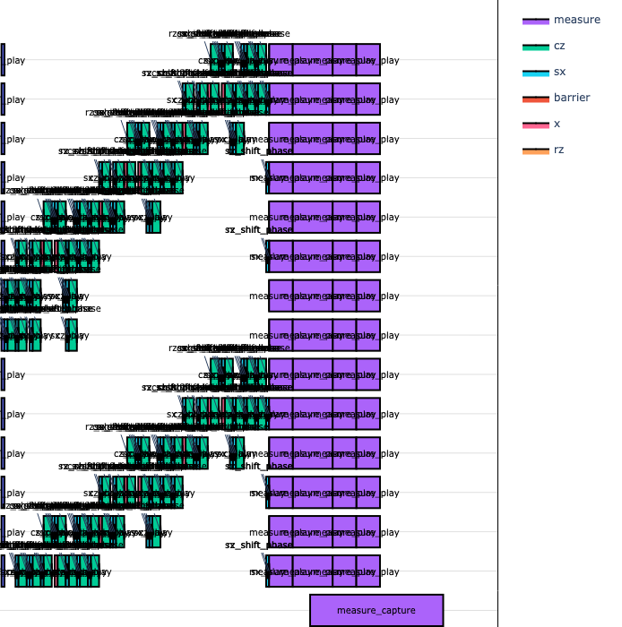
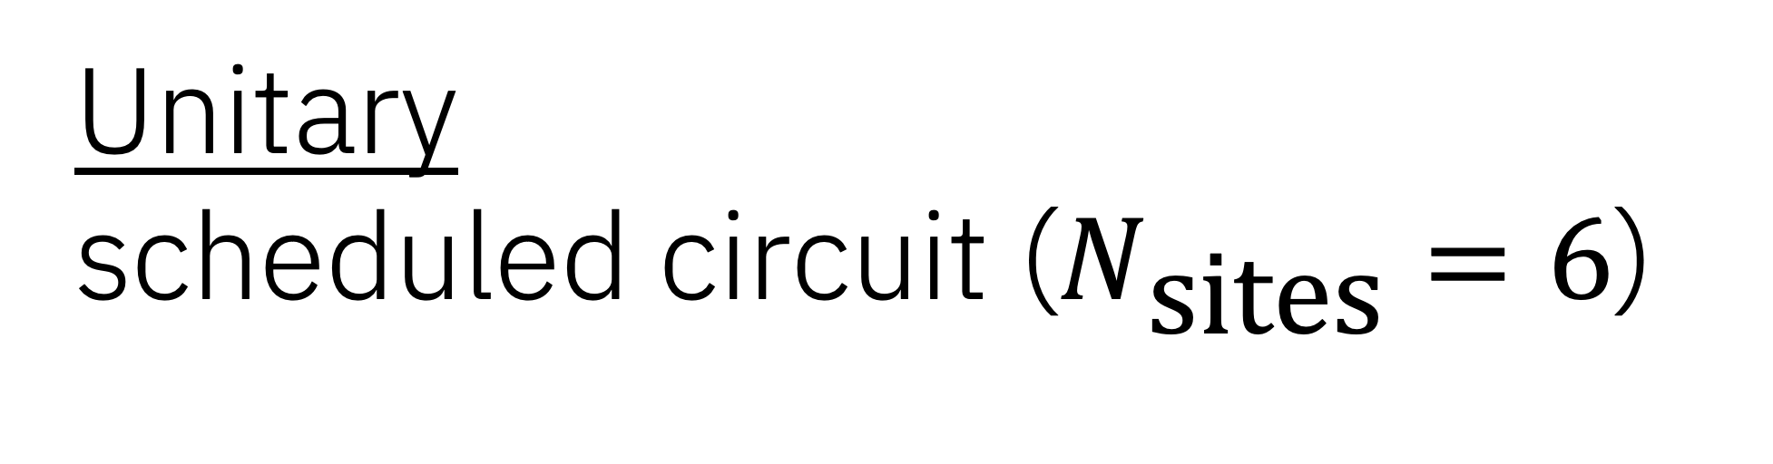
Unitary scheduled circuit ($N_{\text{sites}}=6$)
job.result().metadata["compilation"]["scheduler_timing"]["timing"]
Notes:
To the right, is part of what a job result can return to users in its metadata. Here, the qubits are ordered in physical qubits numbering, top to bottom, so it doesn’t look exactly like the way it looks to the left, that are drawn with virtual qubits ordering. These green blocks represents 2Q gates, while purple blocks are from measurement instructions, and the bottom shifted purple block represents measurement capture. As you see and would expect, as you increase the number of sites in a ladder, the depth of the circuit will increase. Circuit duration is another information you can pull from the metadata returned with job.result. You can learn more on how to use this beta feature during the tutorial session.

Slide 45
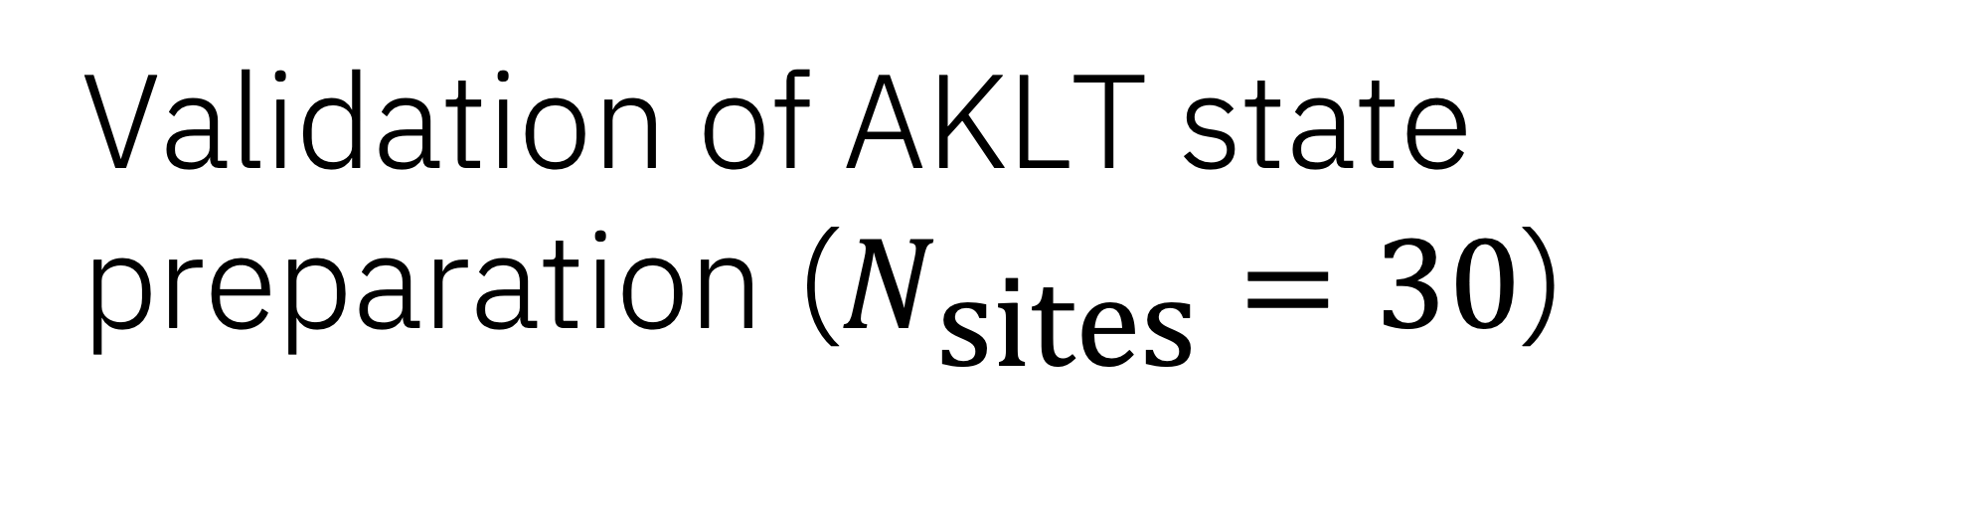
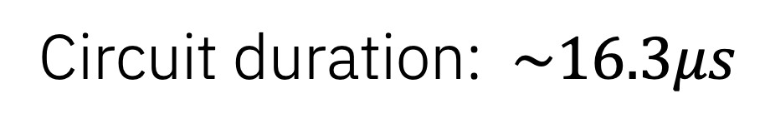
Validation of AKLT state preparation ($N_{\text{sites}}=30$)
Unitary (62 qubits)
Circuit duration: $\sim 16.3μs$
Notes:
Now, let’s see what the string order of lengths=10 at Nsites=30 looks like. When preparing the circuit unitarily, you need 62 qubits, and the total duration of the circuit is over 16us.

Slide 46
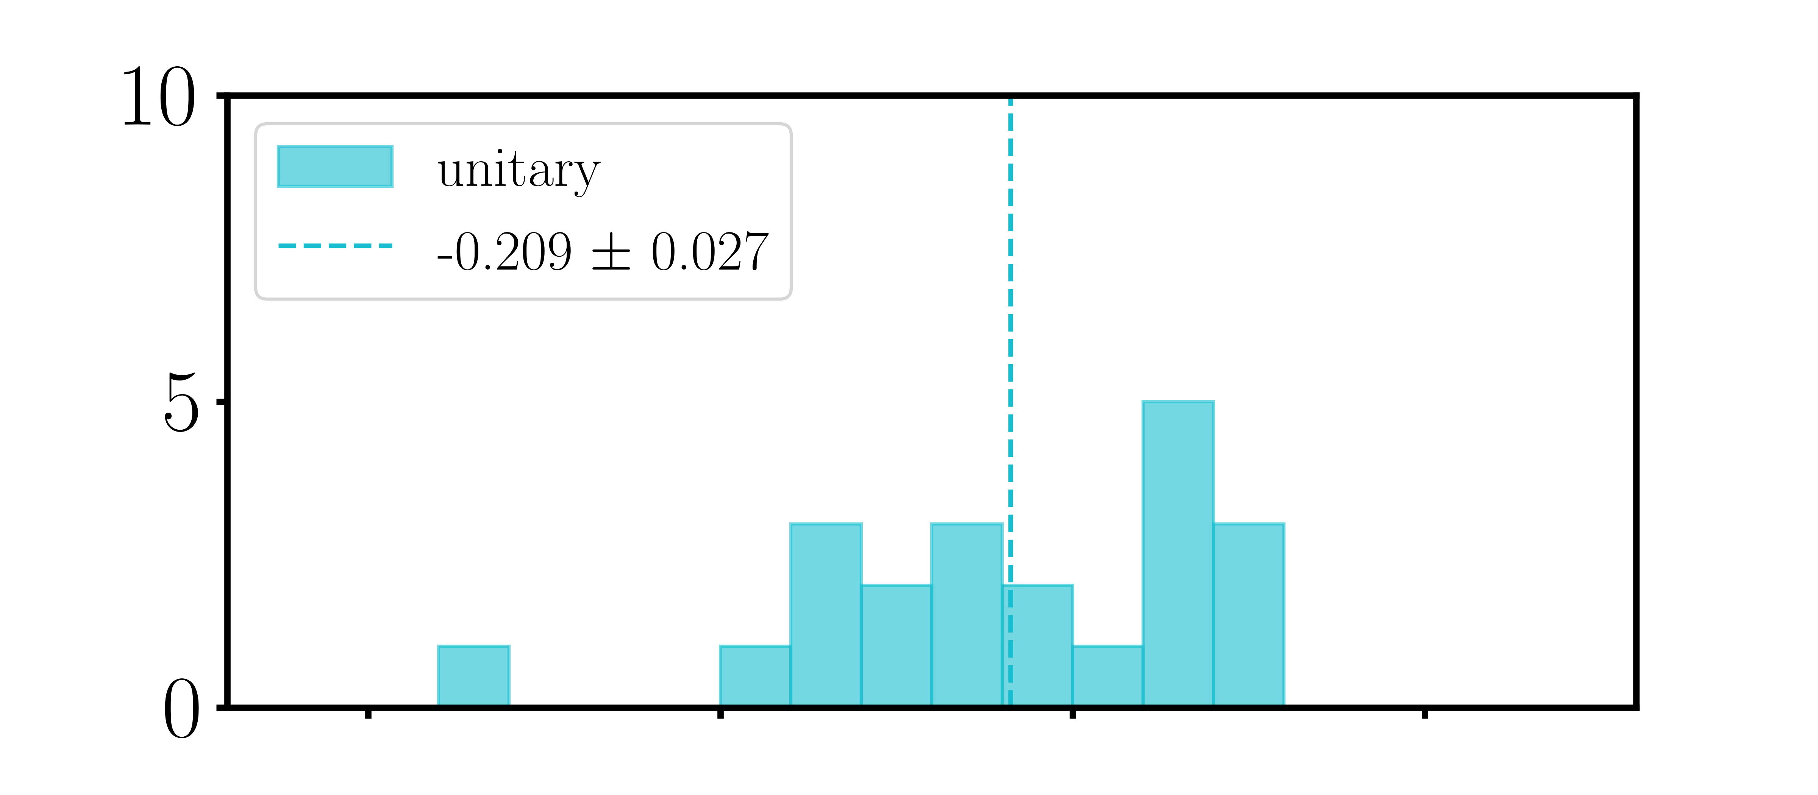
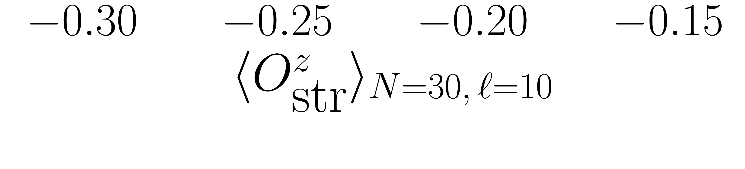

Validation of AKLT state preparation ($N_{\text{sites}}=30$)
Unitary (62 qubits)
$$l=10$$
(62 qubits)
21 x length-10 chains
Circuit duration: $\sim 16.3μs$
Notes:
Looking at the histogram of length=10 string orders, you see there is a wide distribution of the expectation values across 21 different chains, but all non-zero. Remember that the measured expectation value should actually be the same for all different chains

Slide 47
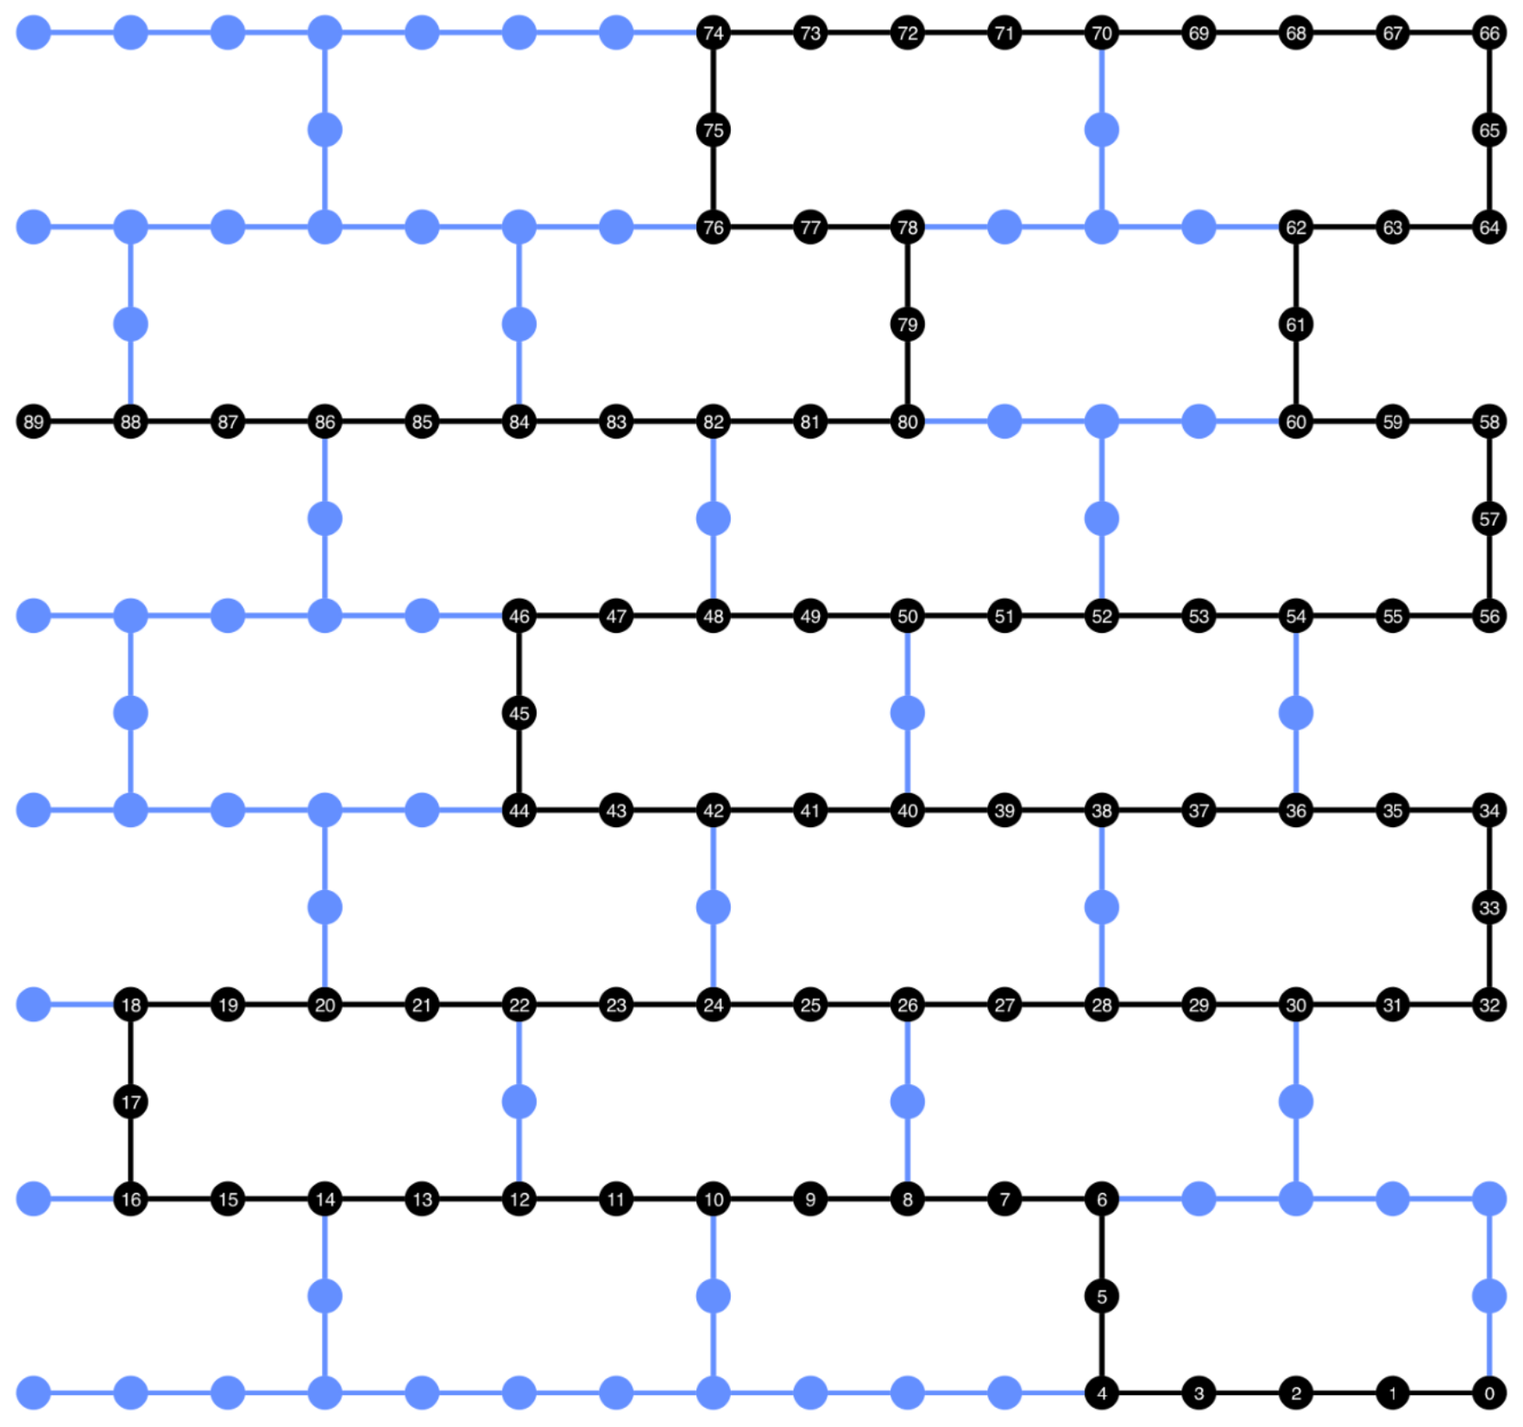
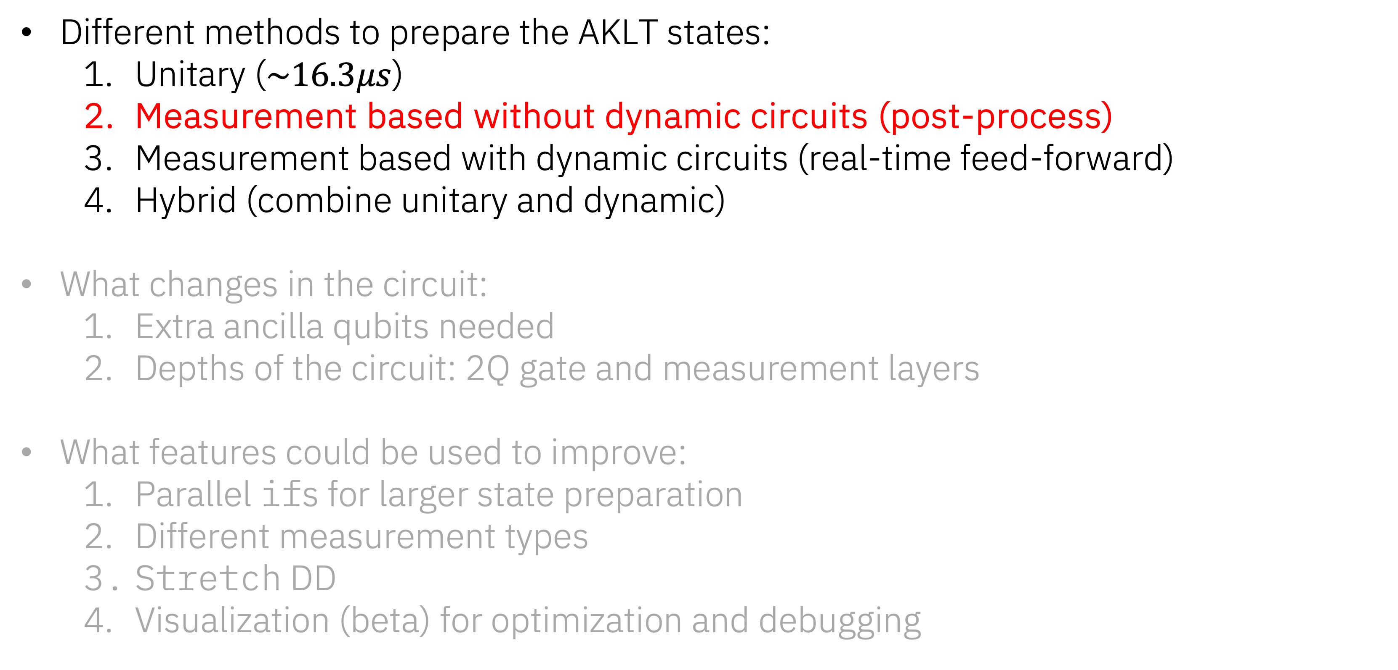
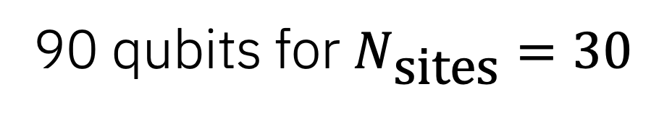
AKLT state preparation with utility scale dynamic circuits
Different methods to prepare the AKLT states:
Unitary ($\sim 16.3μs$)
Measurement based without dynamic circuits (post-process)
Measurement based with dynamic circuits (real-time feed-forward)
Hybrid (combine unitary and dynamic)
What changes in the circuit:
Extra ancilla qubits needed
Depths of the circuit: 2Q gate and measurement layers
What features could be used to improve:
Parallel ifs for larger state preparation
Different measurement types
Stretch DD
Visualization (beta) for optimization and debugging
90 qubits for $N_{\text{sites}}=30$
Notes:
Now, by using measurement based approach, you can generate AKLT state in post-processing, with constant depth. With this approach, you need more ancilla qubits to do so. For N-site=30 example, we now need 90 total qubits.

Slide 48
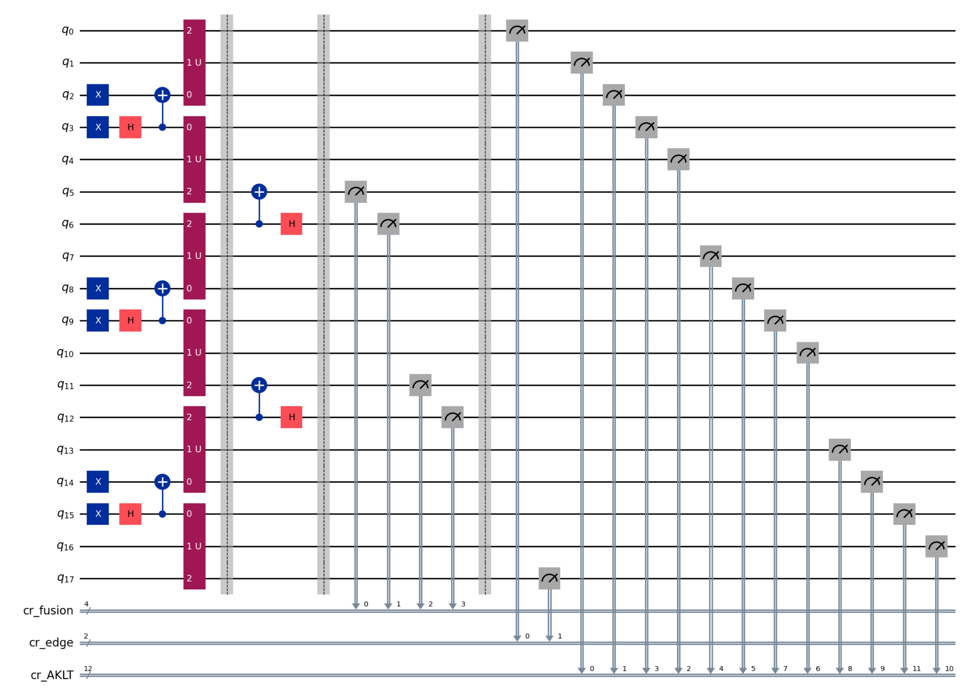
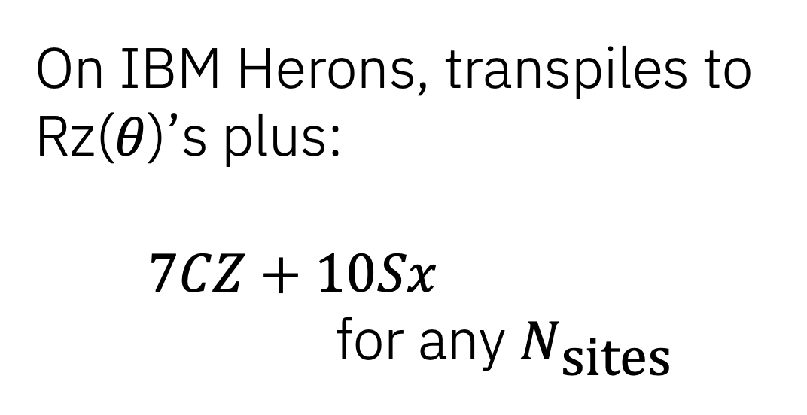
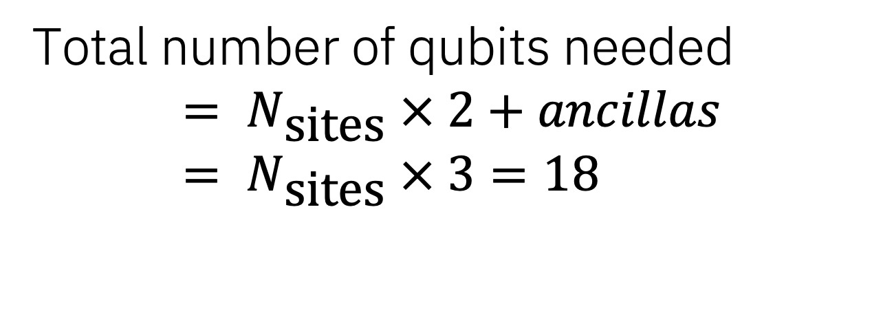

Measurement based AKLT state preparation ($N_{\text{sites}}=6$)
Total number of qubits needed
$$= N_{\text{sites}} × 2+ancillas= N_{\text{sites}} × 3=18$$
On IBM Herons, transpiles to Rz($θ$)’s plus:
$7CZ+10Sx$
for any $N_{\text{sites}}$
Z($θ$)’s plus: $7 × CZ+10 × Sx$
Notes:
But as you can see in this circuit, there is only one layer of these red blocks. As you increase the number of N-sites, you increase the number of ancilla qubits, but not the depth.

Slide 49


Measurement based scheduled circuit ($N_{\text{sites}}=6$)
Z($θ$)’s plus:$7CZ+10Sx$
Notes:
You can checkout the scheduled circuit for this too. In this scheduled circuits, all the measurements, including the ones used for fusion, are played simultaneously with terminal measurements, making this circuit very shallow.

Slide 50

Validation of AKLT state preparation ($N_{\text{sites}}=30$)
Measurement based (90 qubits)
(62 qubits)
21 x length-10 chains
Circuit duration: $\sim 3.8μs$
Notes:
Here, I’m showing all 30 pairs of qubits used for 30 Nsites circled in black. You can see extra qubits in between that are used as ancilla qubits. The circuit to generate with this approach only took 3.8us, which is more than 4 times faster than unitary only circuit.

Slide 51

Validation of AKLT state preparation ($N_{\text{sites}}=30$)
Measurement based (90 qubits)
$$l=10$$
(90 qubits)
(62 qubits)
21 x length-10 chains
Circuit duration: $\sim 3.8μs$
Notes:
Looking at length-10 string orders histogram counts using measurement based approach, you can see the distribution going down, closer to the ideal value of -0.45 with smaller spread.

Slide 52


Measurement based scheduled circuit ($N_{\text{sites}}=6$)
Z($θ$)’s plus:$7CZ+10Sx$
Combine measurement layers or with 2 layers
Notes:
So the measurement based approach that I showed earlier, combined both mid-circuit measurement used for fusion and terminal measurement used for evaluating string order. We can split the two layers up to get a similar approach to when we add real-time feed-forward. You can see in this scheduled circuit, how the circuit duration is longer, with extra measurement and delay in between measurement instructions.

Slide 53




Validation of AKLT state preparation ($N_{\text{sites}}=30$)
$${\left\langle O_{str}^{z}\right\rangle }_{l=10 }$$
Measurement based (90 qubits)
$$l=10$$
(90 qubits)
(62 qubits)
21 x length-10 chains
Circuit duration: $\sim 6.4μs$
Notes:
With this approach, the duration is now longer at 6.4us. When looking at the histogram in pink, the mean goes further from the ideal but the tighter spread compared to unitary approach is preserved.

Slide 54

AKLT state preparation with utility scale dynamic circuits
Different methods to prepare the AKLT states:
Unitary ($\sim 16.3μs$)
Measurement based without dynamic circuits (post-process) ($\sim 3.8μs$)
Measurement based with dynamic circuits (real-time feed-forward)
Hybrid (combine unitary and dynamic)
What changes in the circuit:
Extra ancilla qubits needed
Depths of the circuit: 2Q gate and measurement layers
What features could be used to improve:
Parallel ifs for larger state preparation
Different measurement types
Stretch DD
Visualization (beta) for optimization and debugging
90 qubits for $N_{\text{sites}}=30$
Notes:
Now, let’s see how this looks when you add real-time feed forward. In this example we will be using the first of the new feature: the parallel if statement and conditional operations

Slide 55






Dynamic AKLT state preparation ($N_{\text{sites}}=6$)
Total number of qubits needed
$$= N_{\text{sites}} × 2+ancillas= N_{\text{sites}} × 3=18$$
=
=
Z($θ$)’s plus: $7CZ+10Sx+SWAP \left(3CZ+3Sx\right)+ffwd$
Notes:
Here is a circuit for N-site = 6 prepared using dynamic circuits. Inside the conditional operations, now we have a swap operation for correcting X-defects, and conditional Z for correcting Z-defects. Here, conditional swap adds additional three 2Q gates and 3 single qubit gates, on top of the ffwd time.

Slide 56


Dynamic scheduled circuit ($N_{\text{sites}}=6$)
Notes:
Using the scheduled circuit visualization, we can inspect how long the feedforward operation in this example take. Let’s go through the circuit section one by one.

Slide 57

Dynamic scheduled circuit ($N_{\text{sites}}=6$)
Notes:
First the static part of the circuit, consist of single and two qubit gates.

Slide 58

Dynamic scheduled circuit ($N_{\text{sites}}=6$)
Notes:
Next, a layer of measurements in orange, and a new key in green, at the bottom, called “broadcast”. This green broadcast block overlaps with the orange capture block, but extends by some amount, to allow for time to classify the measurement outcome, and move measurement results around to be used for conditional operations.

Slide 59
Dynamic scheduled circuit ($N_{\text{sites}}=6$)
Notes:
After broadcast, we have “receive” at the top of the visualization, which is when the controllers are ready to process measurement result and apply feedforward operations. The time after receive depends on the complexity of the classical operations, but soon after receive, conditional operations, in this case a swap operation, with three 2Q gates are applied.

Slide 60
Dynamic scheduled circuit ($N_{\text{sites}}=6$)
Notes:
Finally, we have a terminal measurement layers.

Slide 61

AKLT state preparation with utility scale dynamic circuits
Different methods to prepare the AKLT states:
Unitary ($\sim 16.3μs$)
Measurement based without dynamic circuits (post-process) ($\sim 3.8μs$)
Measurement based with dynamic circuits (real-time feed-forward)
Hybrid (combine unitary and dynamic)
What changes in the circuit:
Extra ancilla qubits needed
Depths of the circuit: 2Q gate and measurement layers
What features could be used to improve:
Parallel ifs for larger state preparation
Different measurement types
Stretch DD
Visualization (beta) for optimization and debugging
90 qubits for $N_{\text{sites}}=30$
Notes:
Before showing the string order result using this approach, I want to introduce how you can use Stretch instructions to apply error suppression techniques such as dynamical decoupling.

Slide 62


Dynamic with stretch scheduled circuit ($N_{\text{sites}}=6$)
Notes:
Let’s zoom into the measurement and conditional operation region here. Each of these red blocks represents a stretch delay of some duration. First, we can define stretch delay of “S”, then you can insert “ stretch, pi rotation, stretch, stretch, pi rotation, stretch” to apply a 2-pulse dynamical decoupling sequence during the idle time before conditional operations are applied. Instead of applying the stretch “S” twice in the middle, you can also define a new stretch that is twice as long as stretch “S”. You can learn more on how to use stretch during the tutorial, but let’s see how this looks after scheduling,

Slide 63


Dynamic with stretch scheduled circuit ($N_{\text{sites}}=6$)
Notes:
Looking at the scheduled circuit, you see pi pulses are applied after a delay, another one after two times the delay, and followed by another delay, before the conditional swaps are applied. This is one example of how you might want to schedule a dynamical decoupling sequence during the feedforward time.

Slide 64
AKLT state preparation with utility scale dynamic circuits
Different methods to prepare the AKLT states:
Unitary ($\sim 16.3μs$)
Measurement based without dynamic circuits (post-process) ($\sim 3.8μs$)
Measurement based with dynamic circuits (real-time feed-forward)
Hybrid (combine unitary and dynamic)
What changes in the circuit:
Extra ancilla qubits needed
Depths of the circuit: 2Q gate and measurement layers
What features could be used to improve:
Parallel ifs for larger state preparation
Different measurement types
Stretch DD
Visualization (beta) for optimization and debugging
90 qubits for $N_{\text{sites}}=30$
Notes:
Now, let’s look at the string order result of AKLT state preparation of large N-sites, that was enabled with new parallel if and stretch DD features.

Slide 65


Validation of AKLT state preparation ($N_{\text{sites}}=30$)
Dynamic (90 qubits)
$$l=10$$
(90 qubits)
(90 qubits)
(62 qubits)
21 x length-10 chains
Circuit duration: $\sim 8μs$
Notes:
The circuit of this size now takes around 8us including real-time feedforward and conditional swaps, and you can see the histogram of all length-10 chains in purple.
Now, you might think it went further away from the post-processing result, but when we run the post-processing approach, we did not have a fair comparison. With dynamic circuits, on top of feed-forwad operations, we have to apply mid-circuit measurement and terminal measurements in two layers.

Slide 66
Validation of AKLT state preparation ($N_{\text{sites}}=30$)
Dynamic (90 qubits)
$$l=10$$
(90 qubits)
(90 qubits)
(90 qubits)
(62 qubits)
21 x length-10 chains
Circuit duration: $\sim 8μs$
Notes:
To make a fairer comparison, I ran post-process version of the circuit generation, splitting the measurements in two layers, back to back. The results are shown in pink histogram, showing errors associated with this simple change. Keep in mind however that the feed-forward method allows to coherently prepare the AKLT state and have it available for use

Slide 67

AKLT state preparation with utility scale dynamic circuits
Different methods to prepare the AKLT states:
Unitary ($\sim 16.3μs$)
Measurement based without dynamic circuits (post-process) ($\sim 3.8μs/\sim 6.4μs$)
Measurement based with dynamic circuits (real-time feed-forward) ($\sim 8μs$)
Hybrid (combine unitary and dynamic)
What changes in the circuit:
Extra ancilla qubits needed
Depths of the circuit: 2Q gate and measurement layers
What features could be used to improve:
Parallel ifs for larger state preparation
Different measurement types
Stretch DD
Visualization (beta) for optimization and debugging
90 qubits for $N_{\text{sites}}=30$
Notes:
So, let's review different methods we've looked at so far. Unitary circuit taking over 16us, post-process going from 3.8 to 6.4us when splitting up the measurements, and 8us, when adding real-time feedfoward, including the expensive swap operations applied conditionally.

Slide 68

AKLT state preparation with utility scale dynamic circuits
Different methods to prepare the AKLT states:
Unitary ($\sim 16.3μs$)
Measurement based without dynamic circuits (post-process) ($\sim 3.8μs/\sim 6.4μs$)
Measurement based with dynamic circuits (real-time feed-forward) ($\sim 8μs$)
Hybrid (combine unitary and dynamic)
What changes in the circuit:
Extra ancilla qubits needed
Depths of the circuit: 2Q gate and measurement layers
What features could be used to improve:
Parallel ifs for larger state preparation
Different measurement types
Stretch DD
Visualization (beta) for optimization and debugging
90 qubits for $N_{\text{sites}}=30$
Notes:
We still haven’t used all the new features yet… Now, let me introduce different measurement types to this circuit. And let me say, this is one of my favorite additions to our capabilities.

Slide 69

Dynamic AKLT state preparation ($N_{\text{sites}}=6$)
MidCircuitMeasure instruction
Notes:
In the mid-circuit measurement layer here, you can now choose to use the new MidCircuitMeasure instruction instead of default Measure. Our new MidCircuitMeasure instruction is tied to a new measurement called measure_2, and we have calibrated so that they are faster and suitable for mid-circuit.

Slide 70

Dynamic with original measure scheduled circuit
measure
Capture length: 1440ns
0
2000ns
4000ns
Notes:
Here is the original circuit, where default measure capture length is 1.44us.

Slide 71



Dynamic with measure_2 scheduled circuit
measure
Capture length: 1440ns
Readout error
measure_2
2000ns
4000ns
Capture length: 500ns
Notes:
Now using a new MidCircuitMeasure instruction, the circuit is shortened by almost a microsecond. Here, I am plotting out assignment errors comparing default measure in purple and measure_2 in orange, on the 90 qubit string used for this demonstration. As you see, the error goes up slightly for measure_2, but not by a lot, maintaining sub half a percent error median for both approaches.

Slide 72


Validation of AKLT state preparation ($N_{\text{sites}}=30$)
Dynamic (90 qubits)
$$l=10$$
(90 qubits)
(90 qubits)
(90 qubits)
(62 qubits)
21 x length-10 chains
Circuit duration: $\sim 7.1μs$
Notes:
Now using this approach, we now have a circuit duration of around 7us. This can further bring down the expectation value of the string order of length-10 chains closer to the ideal value, now plotted in orange.

Slide 73



AKLT state preparation with utility scale dynamic circuits
Different methods to prepare the AKLT states:
Unitary ($\sim 16.3μs$)
Measurement based without dynamic circuits (post-process) ($\sim 3.8μs$/$\sim 6.4μs$)
Measurement based with dynamic circuits (real-time feed-forward) ($\sim 8μs$/$7.1μs$)
Hybrid (combine unitary and dynamic)
What changes in the circuit:
Extra ancilla qubits needed
Depths of the circuit: 2Q gate and measurement layers
What features could be used to improve:
Parallel ifs for larger state preparation
Different measurement types
Stretch DD
Visualization (beta) for optimization and debugging
86 qubits for $N_{\text{sites}}=30$
Notes:
Finally, I want to share a hybrid approach that utilizes the “idle” time during the feedforward operations. Another new feature that I am very excited about.

Slide 74



Dynamic ($N_{\text{sites}}=4$) plus unitary ($N_{\text{sites}}=2$) extension
Total number of qubits needed
$$= N_{\text{sites}} × 2+ancillas= N_{\text{sites}} × 2+\left(N_{\text{sites}}−2\right)=16$$
=
=
Notes:
Here, for Nsite=6 example, we can split up 4 sites to be prepared with measurement based approach, and (1) two extra sites extended, one to the "left" -- in this circuit added on the top, and one to the "right", added to the bottom.
These gates are applied while we have idling time from measurement and feedforward. So there is no extra "cost" in terms of depths, associated with it.

Slide 75

Validation of AKLT state preparation ($N_{\text{sites}}=30$)
Dynamic + (L2+R2) unitary
extension (86 qubits)
(90 qubits)
(90 qubits)
(90 qubits)
(62 qubits)
21 x length-10 chains
Circuit duration: $\sim 6.9μs$
Notes:
In fact, using this approach reduces the number of qubits needed, while also reducing the duration slightly, as we decreased the classical complexity. For Nsite=30 example, I added 2-sites each in both directions, so total of 26-measurement based and 4 with unitary approach.

Slide 76

Validation of AKLT state preparation ($N_{\text{sites}}=30$)
Dynamic + (L2+R2) unitary
extension (86 qubits)
(86 qubits)
$$l=10$$
(90 qubits)
(90 qubits)
(90 qubits)
(62 qubits)
21 x length-10 chains
Circuit duration: $\sim 6.9μs$
Notes:
This required 86 qubits, and further decrease the length-10 string orders, shown in green histogram. Now, I want to show one more set of data. I promise, this is it, and summarize my observations.

Slide 77





DD or no DD???
DD
No DD
(86 qubits)
(90 qubits)
(90 qubits)
(90 qubits)
(62 qubits)
Notes:
DD or no DD? That is the question. All the data that I have shown so far had been with dynamical decoupling inserted in both unitary section of the circuit, and non-unitary section, using stretch DD.
The right column of data is equivalent to what I showed earlier, but without DD. Note that I have now changed the x-axis as the results were worse without, as you might expect. But the biggest impact was in fact on unitary circuit. Without DD, the mean string order was much higher, and performed a lot worse than measurement based and dynamic circuit approach.
The impact is smaller, but we do see some improvement in stretch DD on dynamic circuits method. Now, I am not claiming that dynamic circuits is beating the unitary approach in this example, but the main point I want to highlight is the spread of string order across the long chain. You see the unitary case on the bottom, DD or no DD, have large spread. Which is pointing to the fact that we might not be preparing the state as evenly as we’d like. Using the measurement approach and layering the gates, having shallow depth circuit is getting us to as good or sometimes better result with much tighter bounds. I am very excited to see this trend, and on top of that, the fact that we are still seeing a good signal without any type of error mitigation, to me, is a great sign that we are moving in the right direction.

Slide 78


AKLT state preparation ($N_{\text{sites}}=30$)
Different methods to prepare the AKLT states:
Unitary ($\sim 16.3μs$)
Measurement based without dynamic circuits (post-process) ($\sim 3.8μs$/ $\sim 6.4μs$)
Measurement based with dynamic circuits (real-time feed-forward) ($\sim 8μs$/$\sim 7.1μs$)
Hybrid (combine unitary and dynamic) ($\sim 6.9μs$)
What changes in the circuit:
Extra ancilla qubits needed
Depths of the circuit: 2Q gate and measurement layers
What features could be used to improve:
Parallel ifs for larger state preparation
Different measurement types
Stretch DD
Visualization (beta) for optimization and debugging
Notes:
So, that was a lot of new features and data showcased. I have highlighted the approximate circuit duration for each method, for preparing 30-site AKLT state on ibm_Pittsburgh. I want to emphasize that prior to the re-introduction of this dynamic circuits capability, this circuit would have taken over 20us longer than shown here for dynamic circuits approach. Which would have defeated the purpose of using measurement based compared to unitary case, in a large scale demonstration.

Slide 79

Summary
Parallel ifs enable utility scale experiments
More than one type of measurement enabled: MidCircuitMeasure instruction that maps to measure_2
Added Stretch as durations for Delay instructions for deferred timing resolution
Circuit timing visualization (beta) on dynamic circuits returned to users
Notes:
I hope this talk gave you an introduction to new features that we can use with our dynamic circuits capability that sparks your curiosity in utilizing dynamic circuits into your research. Please visit our documentation, and learn further on how to use these feature during the tutorial session this afternoon. Thank you.

